Slide 1
HFXforPDN.com Patient Assessment Optimization Goals
S004596 V1.0
Increase Conversion Rate on Mobile
Reduce Scrolling to Improve UX Experience
Generate Pull Through by Showing Positive Outcomes of Patients
Update Branding to Consumer Friendly Look/Feel
Simplify Copy

Slide 2
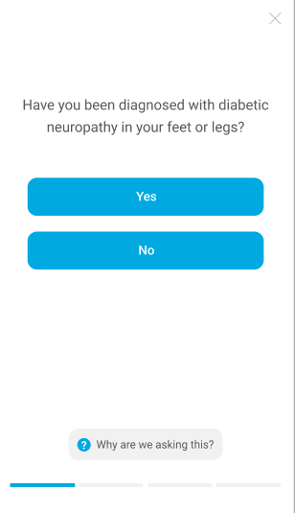
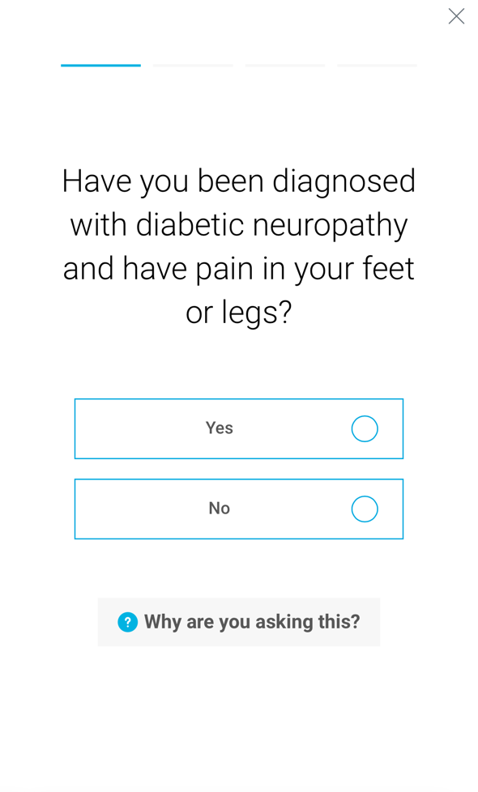
HFXforPDN.com Patient Assessment
Current
New

Slide 3
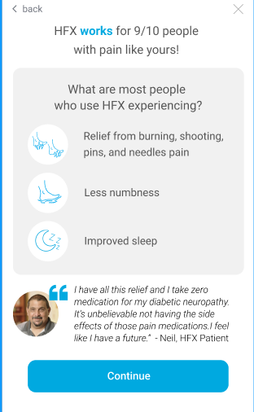
HFXforPDN.com Patient Assessment
New → if answer is yes
Please note we’re space constrained to fit this screen on mobile and don’t have room to cite the studies however these claims on are also on the website and the patients can see the sources there.
1-2
from diabetic neuropathy pain
Improved feeling in feet
Better

Slide 4
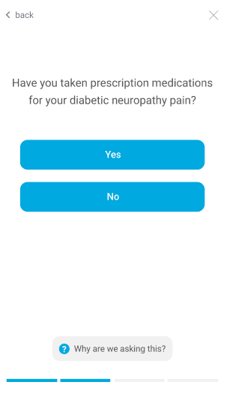
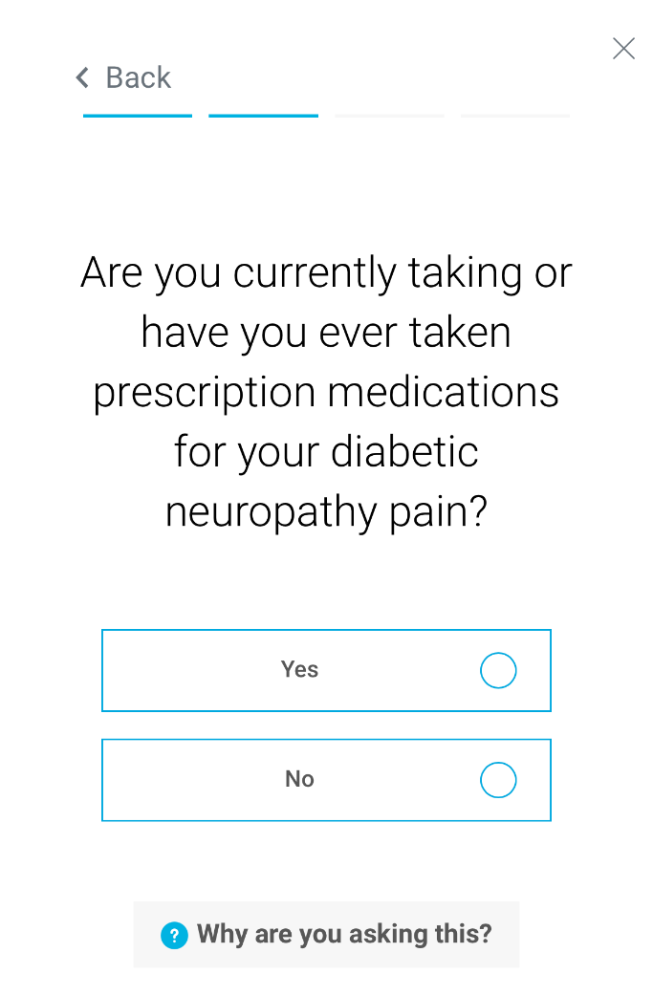
HFXforPDN.com Patient Assessment
Current
New

Slide 5
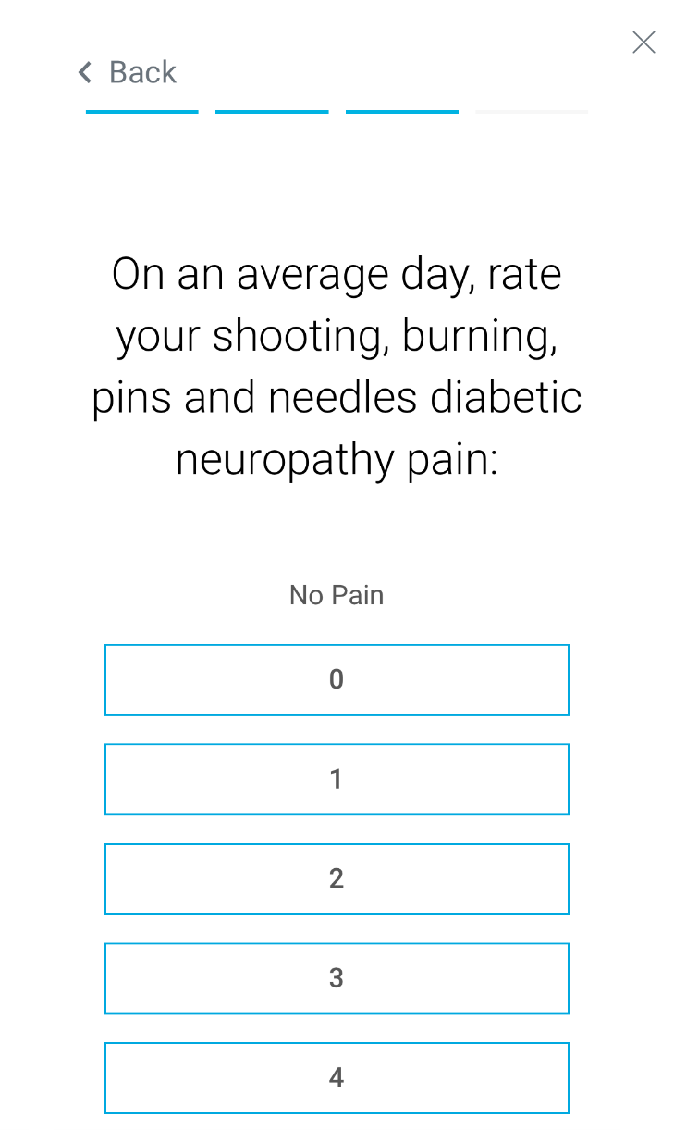
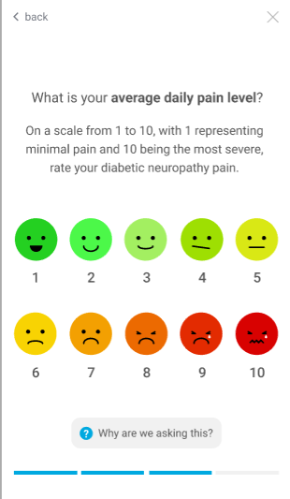
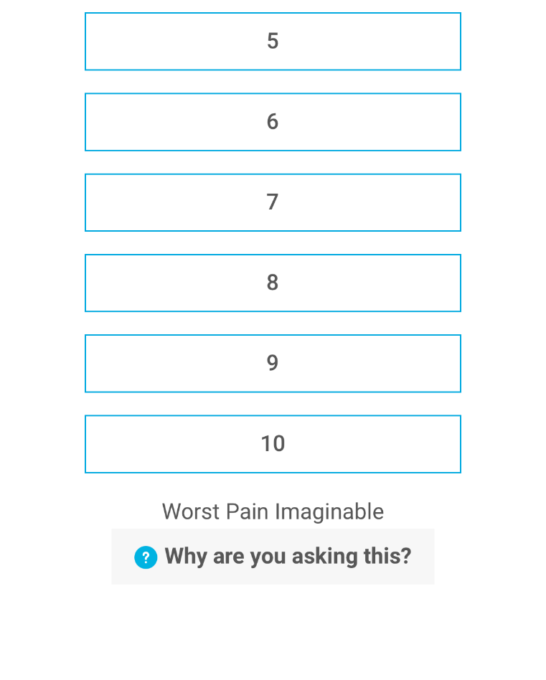
HFXforPDN.com Patient Assessment
Current
New

Slide 6
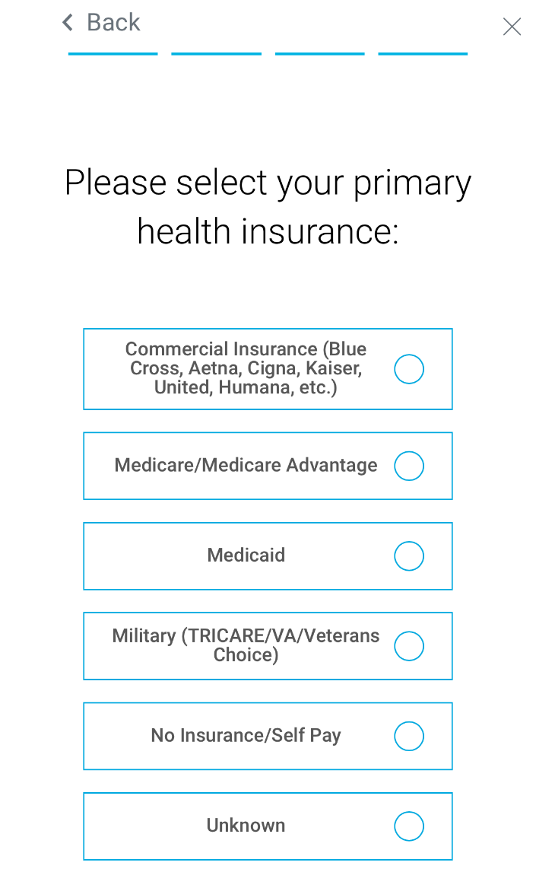

HFXforPDN.com Patient Assessment
Current
New

