Slide 1

Nevro PDN Comparative Ads Creative Concepts 2.0
November 4, 2024

Slide 2
What to expect
What you’ll see
3x animated in-feed versions
3x static in-feed versions
Things to note
Media recommends 4x5 for animated assets, and 1x1 for static. We’ve updated the storyboard sizes accordingly. Once approved, we will also convert the designs to 9x16.
Creative Concepts

Slide 3
Creative Concepts

Slide 4
SOCIAL
Animated In-Feed

Slide 5

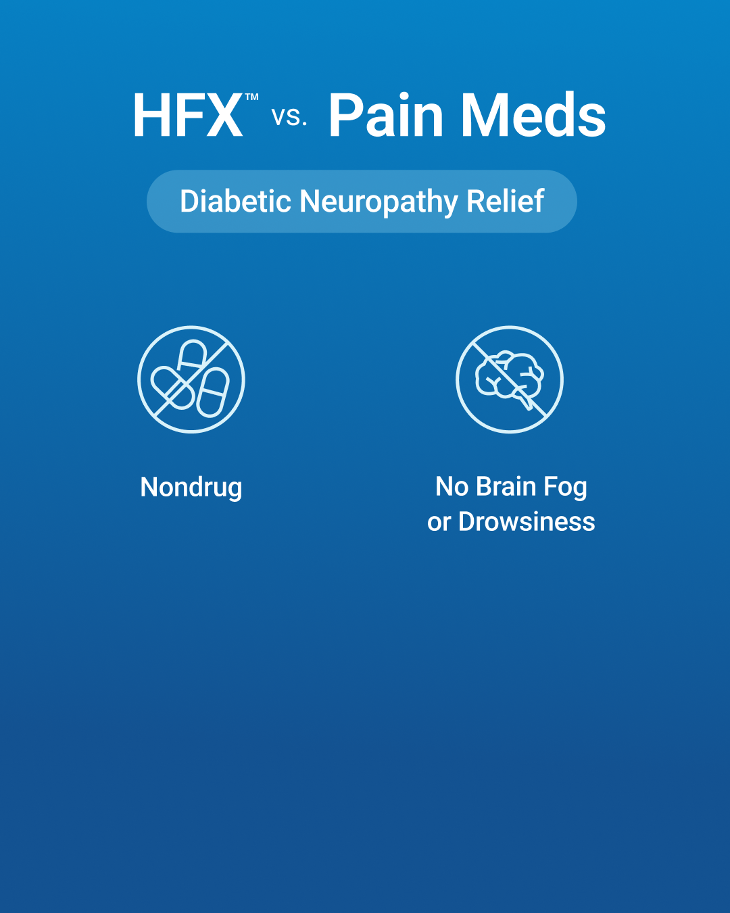
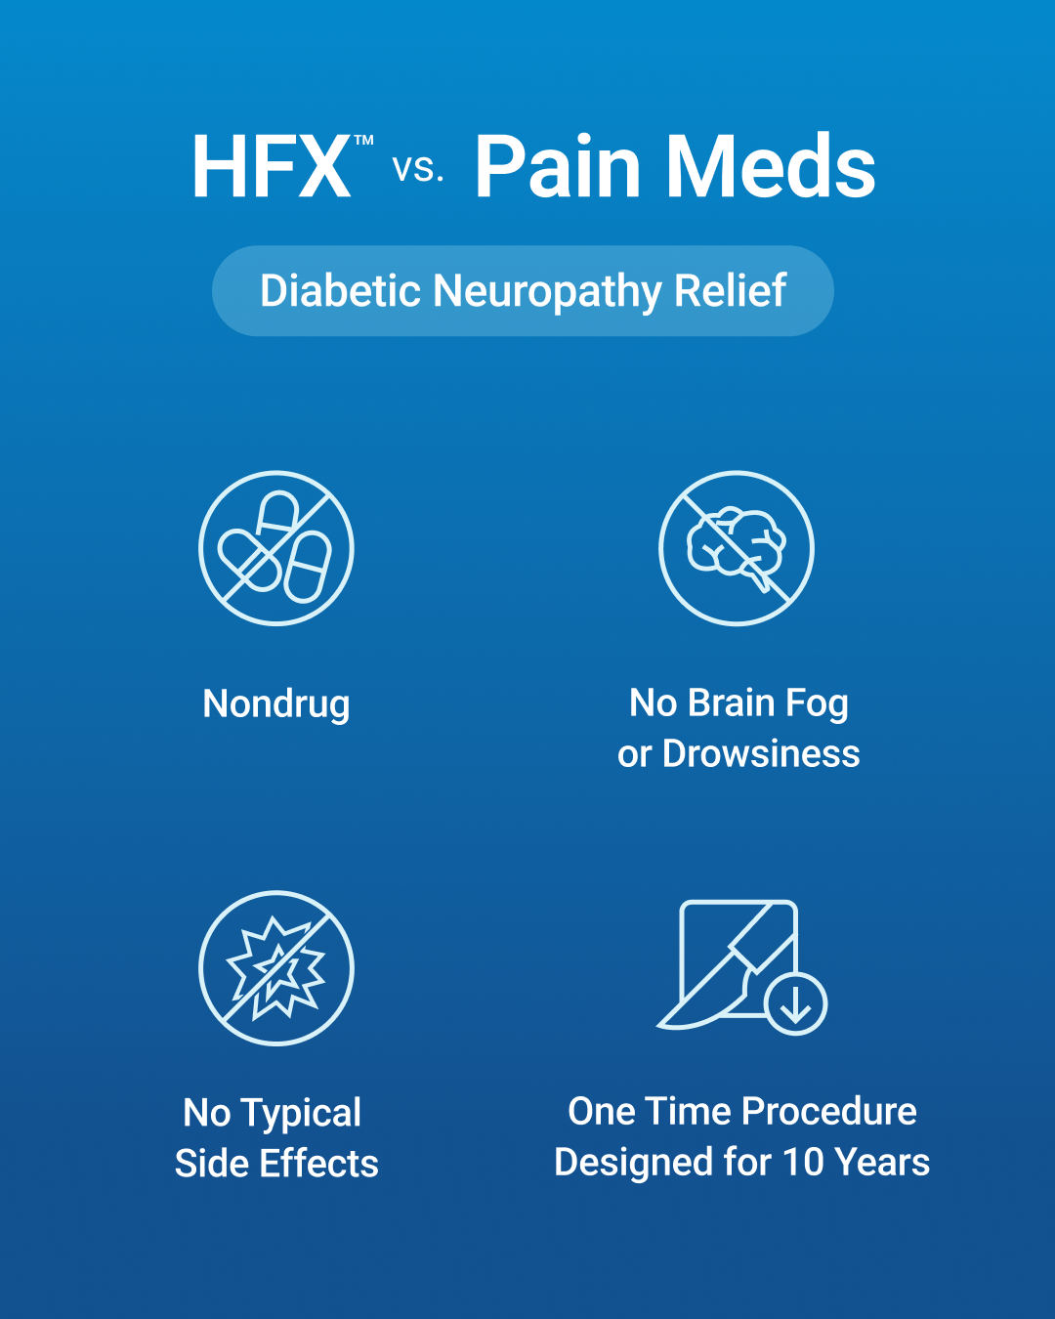
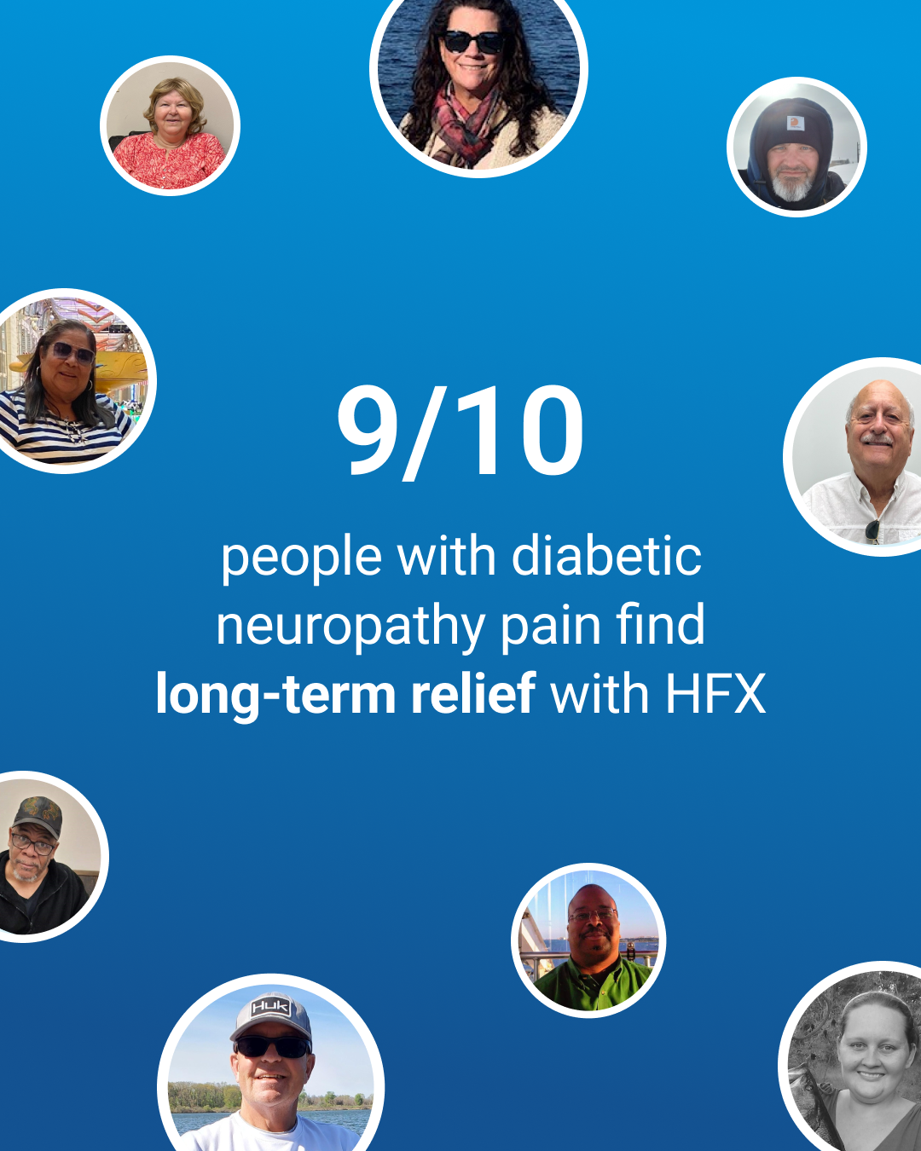

ANIMATED IN-FEED
Version 1
1080x1350
Begin on a headline. Icons and benefits fade in one by one.
Pan right to our 9/10 message. Bubbles of patients pop in and float around it.
Pan right to our 9/10 message. Bubbles of patients pop in and float around it.
🔥 🦶 There’s now a better nondrug way to manage diabetic neuropathy pain in your feet and legs.
Pan right to a phone with the assessment.

Slide 6
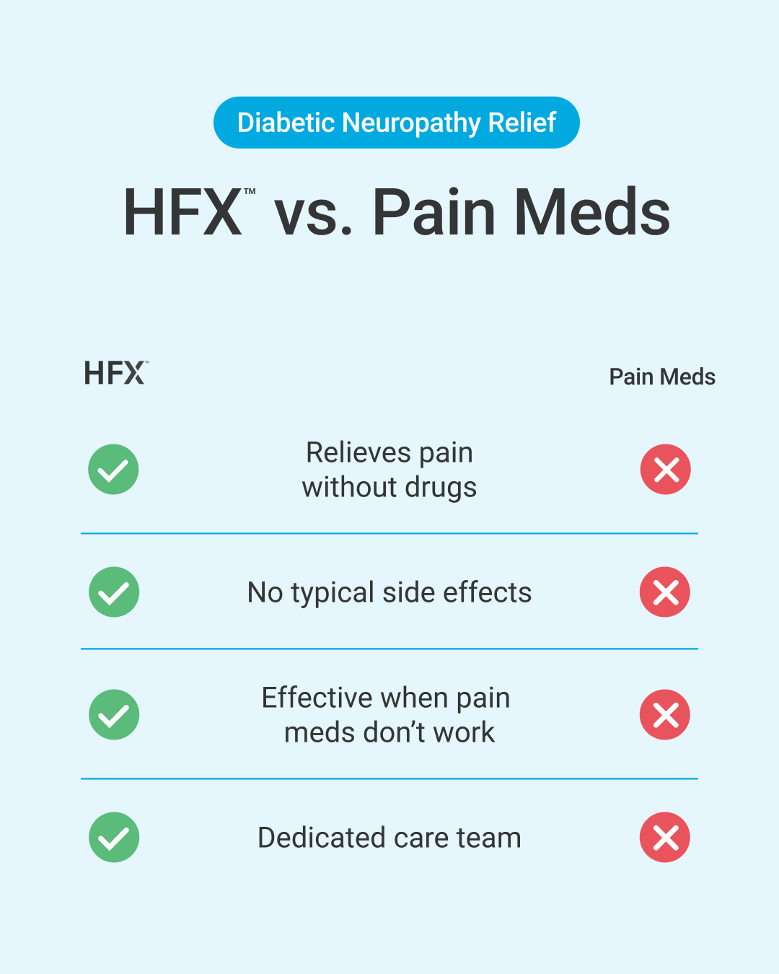
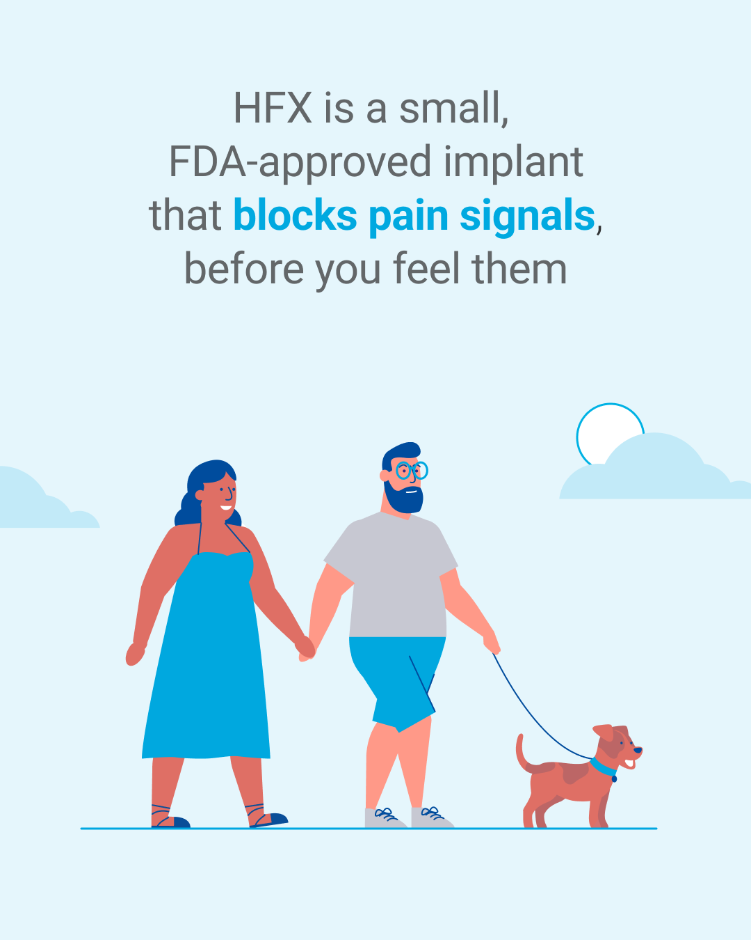
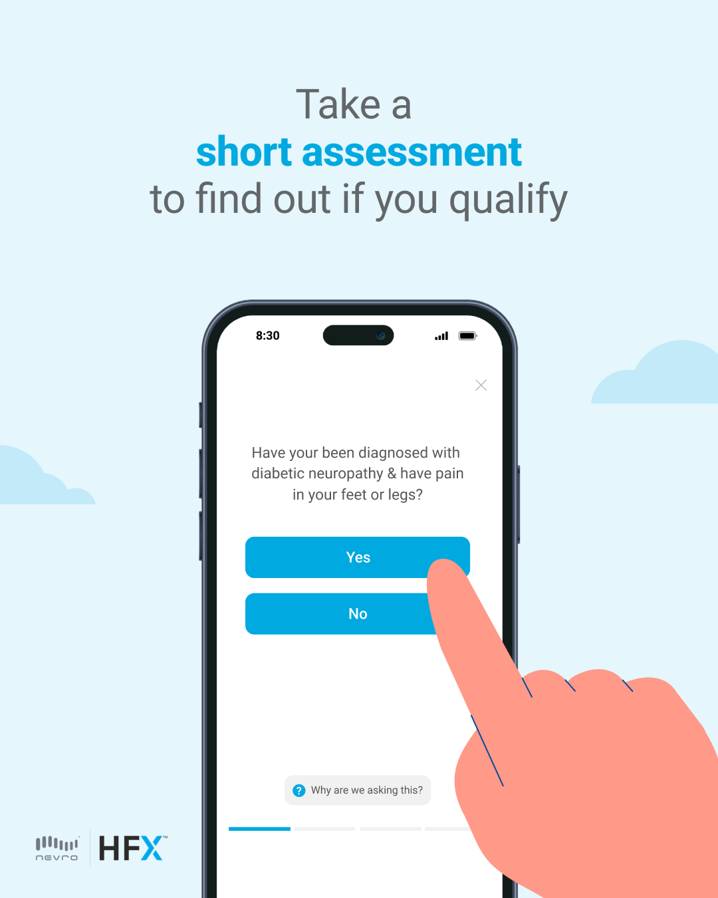
ANIMATED IN-FEED
Version 2
1080x1350
Begin on our comparison chart. Benefits and check marks/crosses fade in row by row..
Pan right to reveal our scene of the patient and his partner walking their dog. Clouds move slowly behind.
🔥 🦶 There’s now a better nondrug way to manage diabetic neuropathy pain in your feet and legs.
Pans to our assessment, a finger clicks the button.

Slide 7
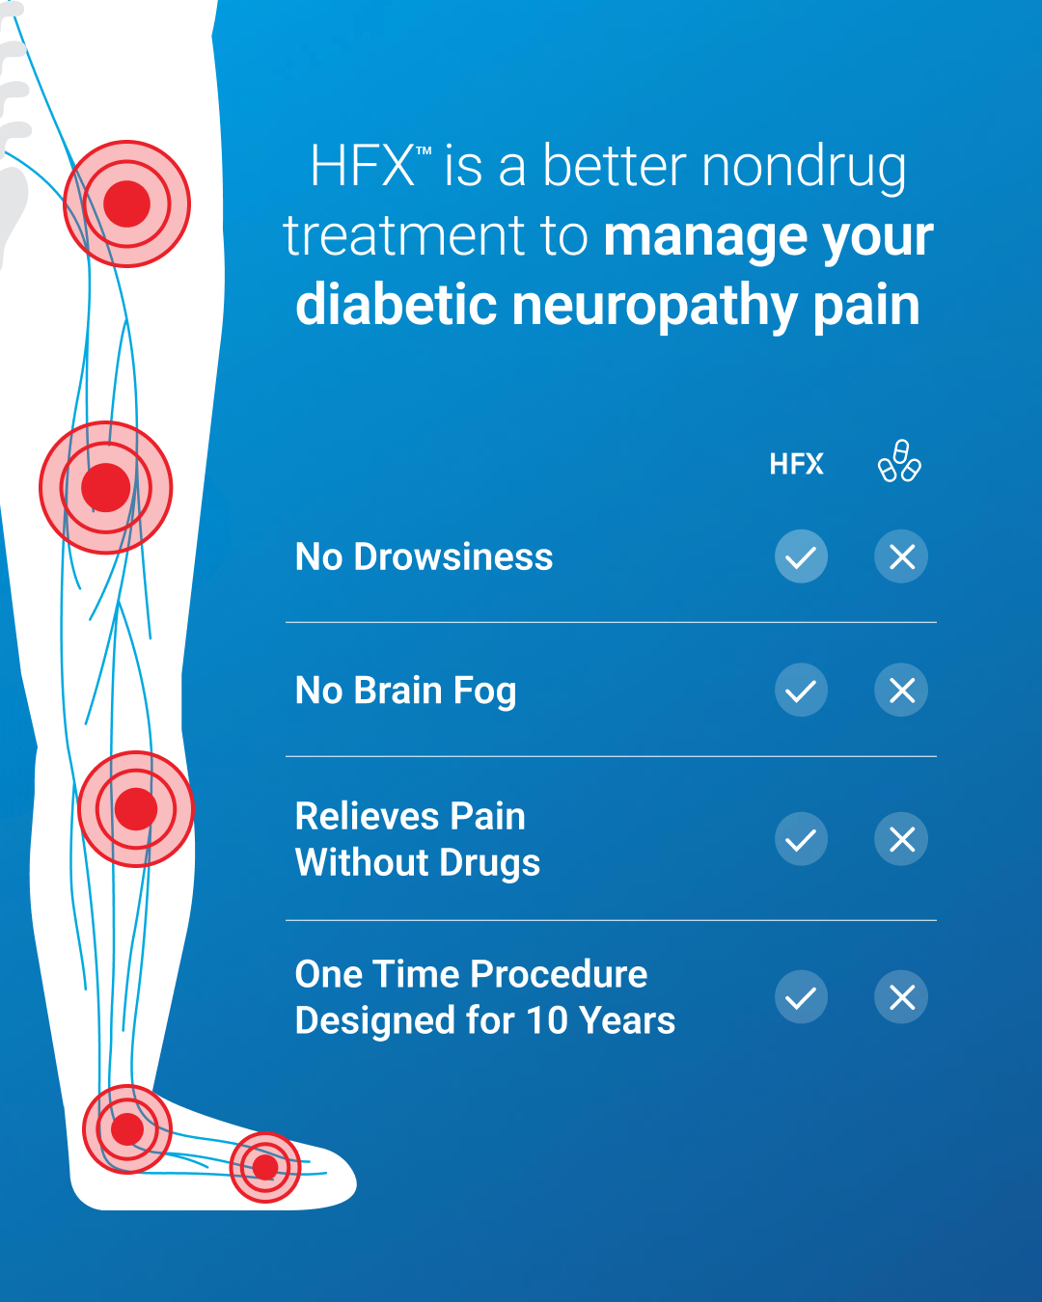


ANIMATED IN-FEED
Version 3
1080x1350
Begin on our comparison chart, which fades in in row by row. The x-ray leg to the left of the screen has pain signals pulsing up.
Pan right to reveal our scene of the patient and their doctor speaking.
🔥 🦶 There’s now a better nondrug way to manage diabetic neuropathy pain in your feet and legs.
Slide to the final frame, looking over the shoulder of a patient. Green checkmark pops up on phone slightly after.

Slide 8
SOCIAL
Static In-feed

Slide 9
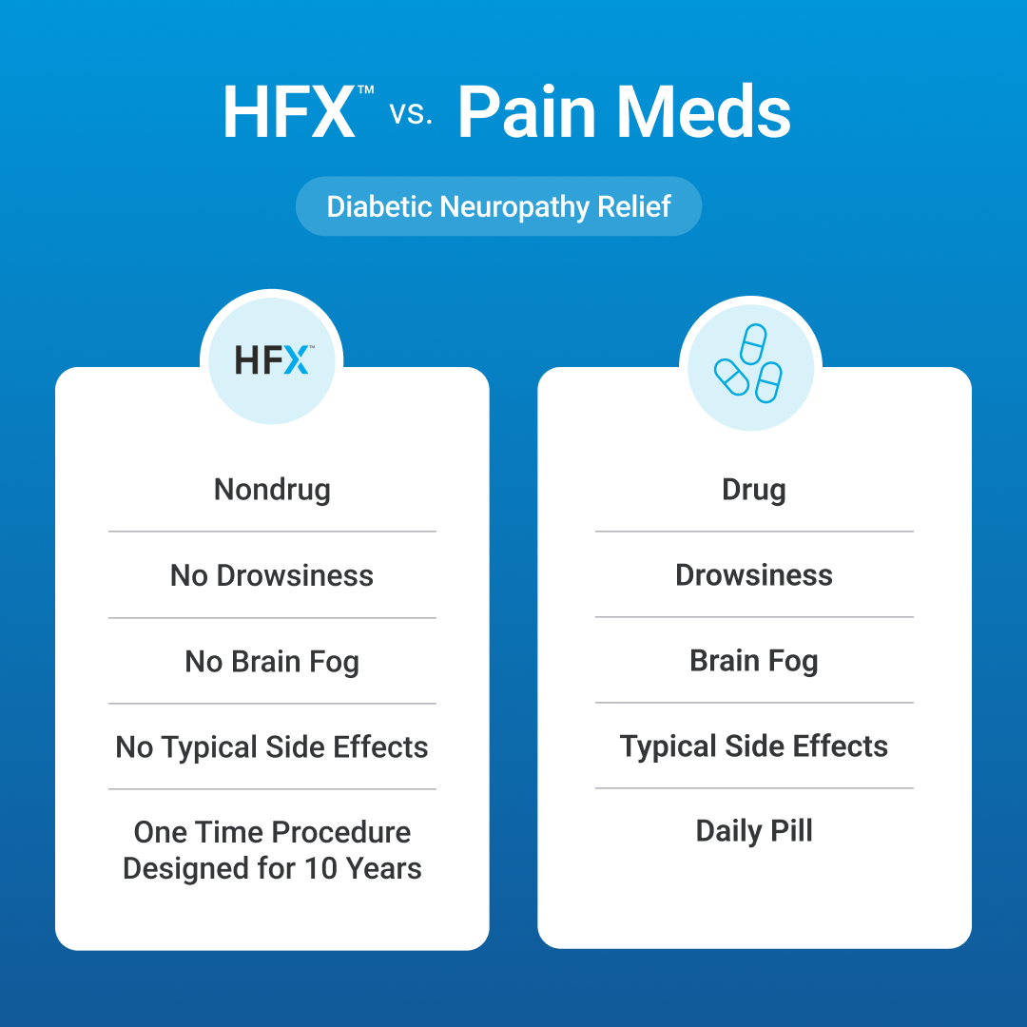
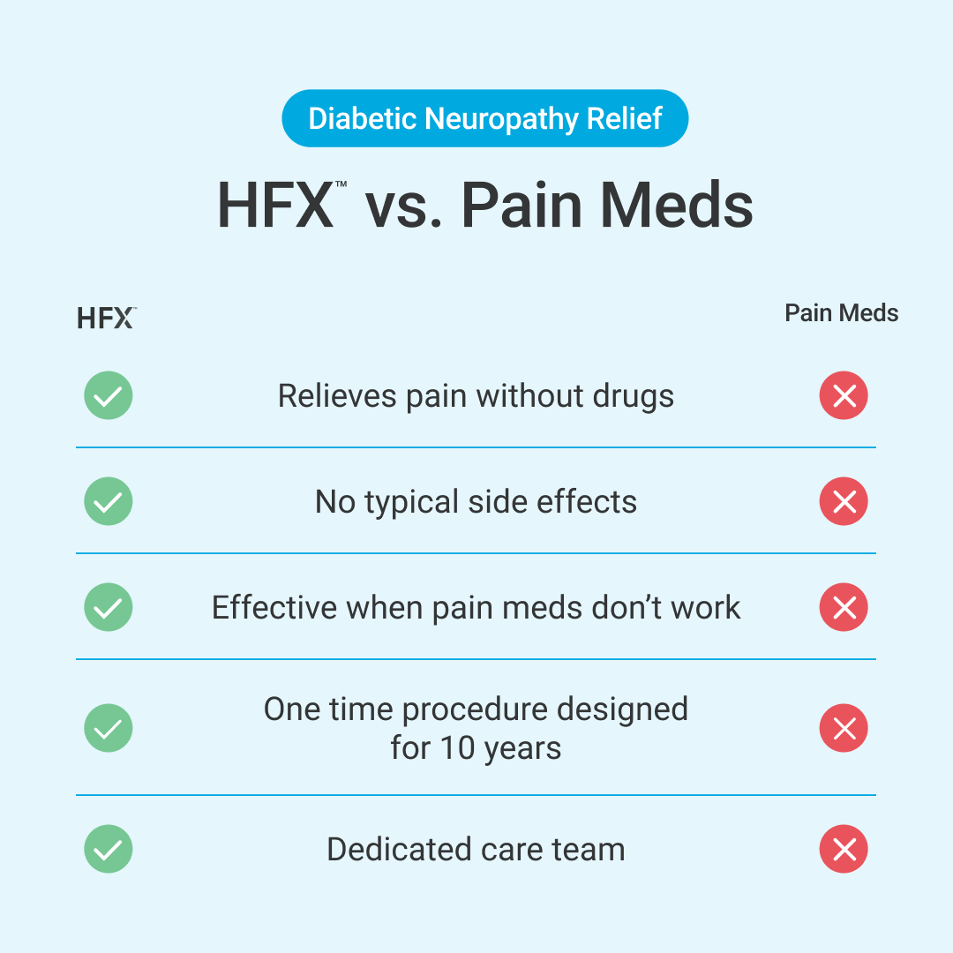
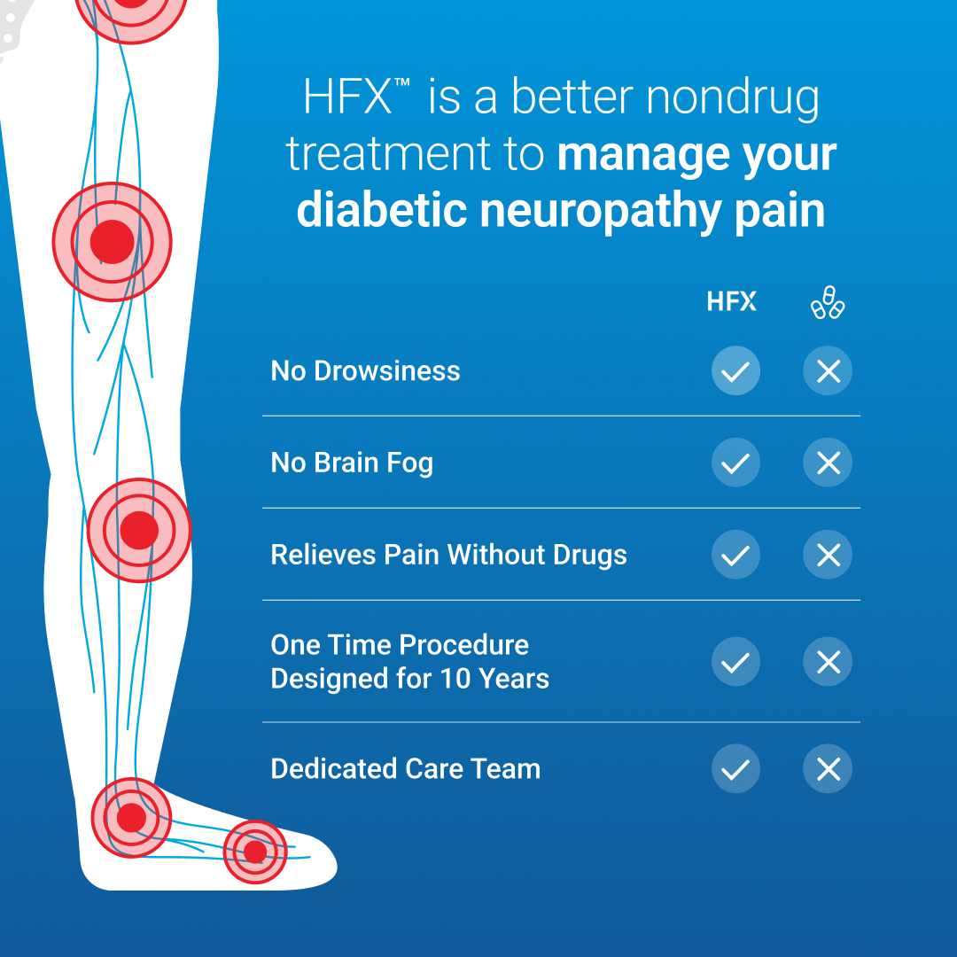
STATIC IN-FEED
Static
Versions
1080x1080
🔥 🦶 There’s now a better nondrug way to manage diabetic neuropathy pain in your feet and legs.
🔥 🦶 There’s now a better nondrug way to manage diabetic neuropathy pain in your feet and legs.
🔥 🦶 There’s now a better nondrug way to manage diabetic neuropathy pain in your feet and legs.
Version 1
Version 2
Version 3

Slide 10
Thank you.

