Slide 1
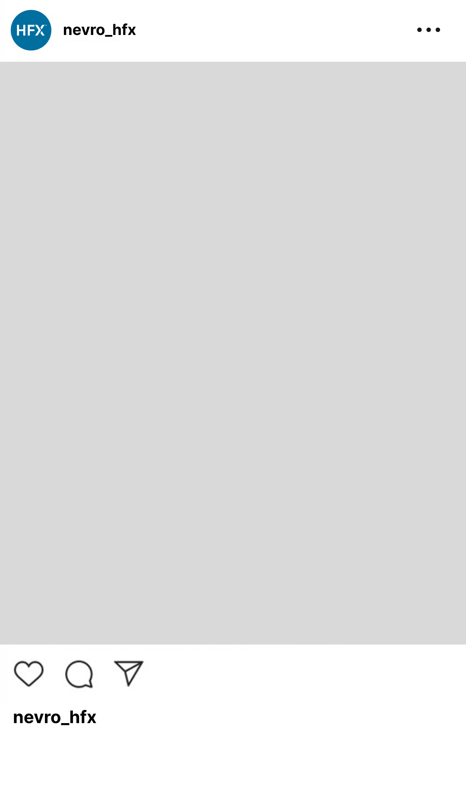
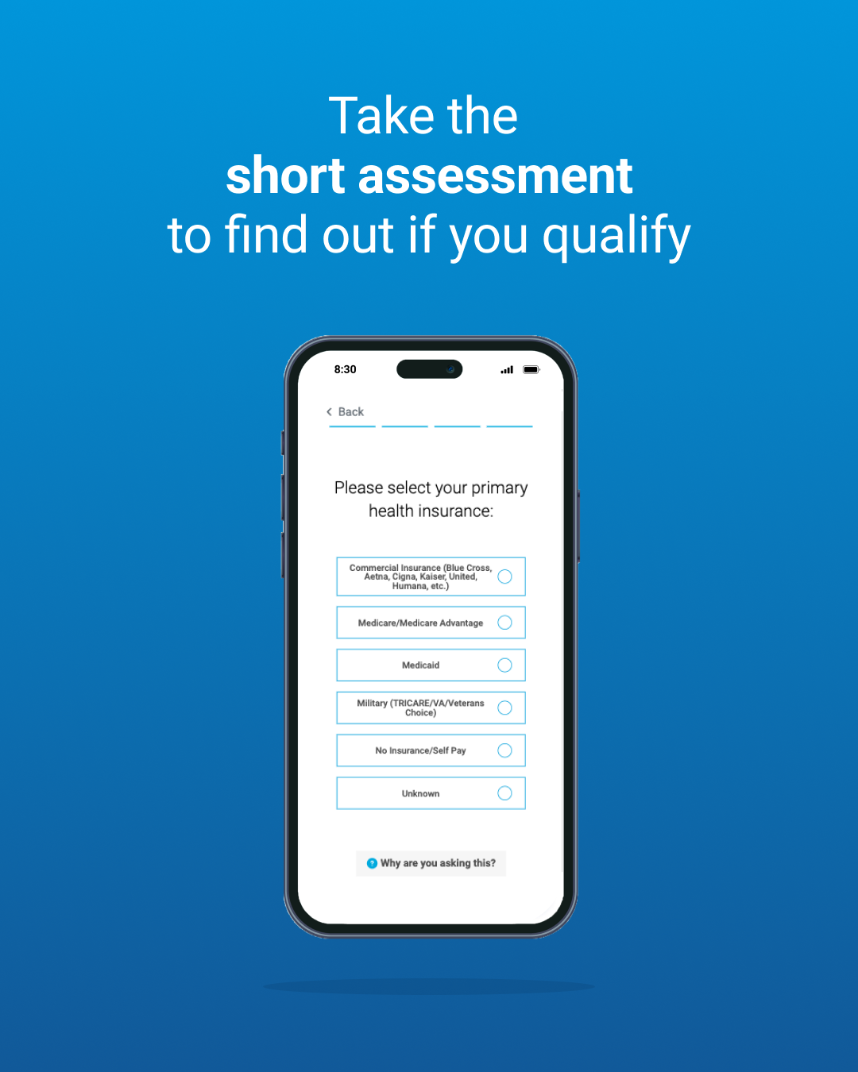
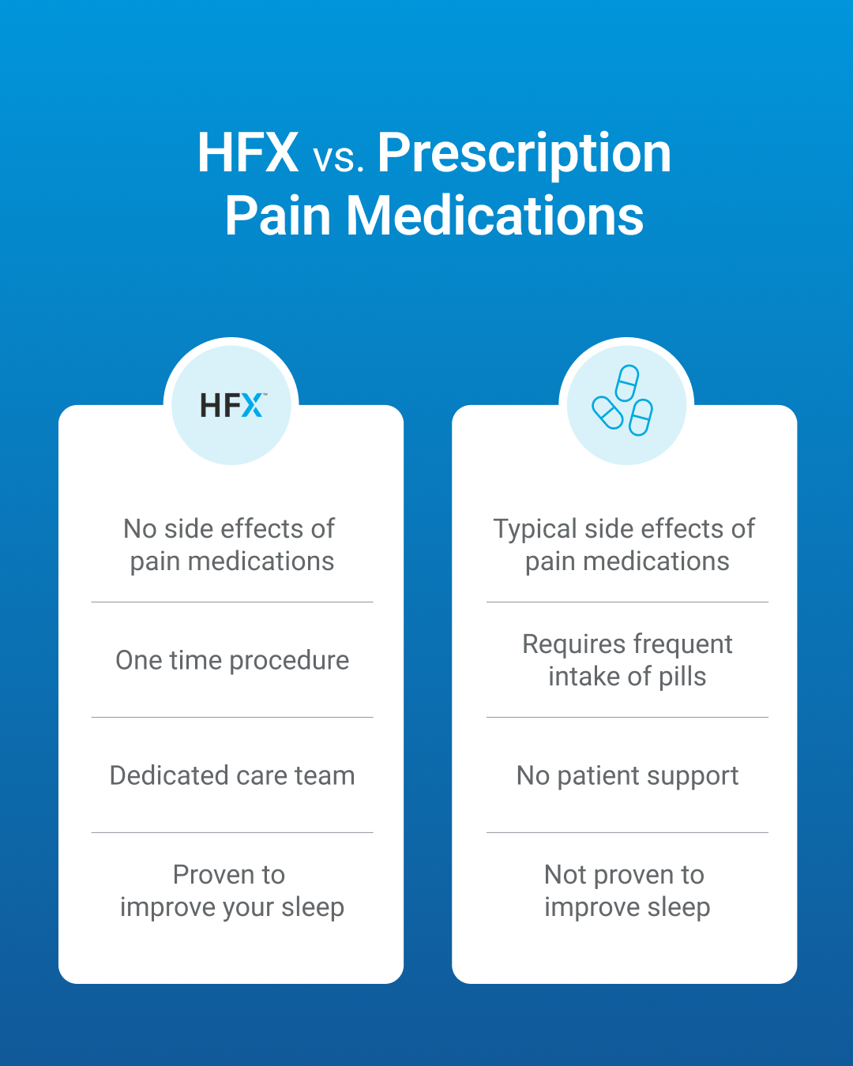
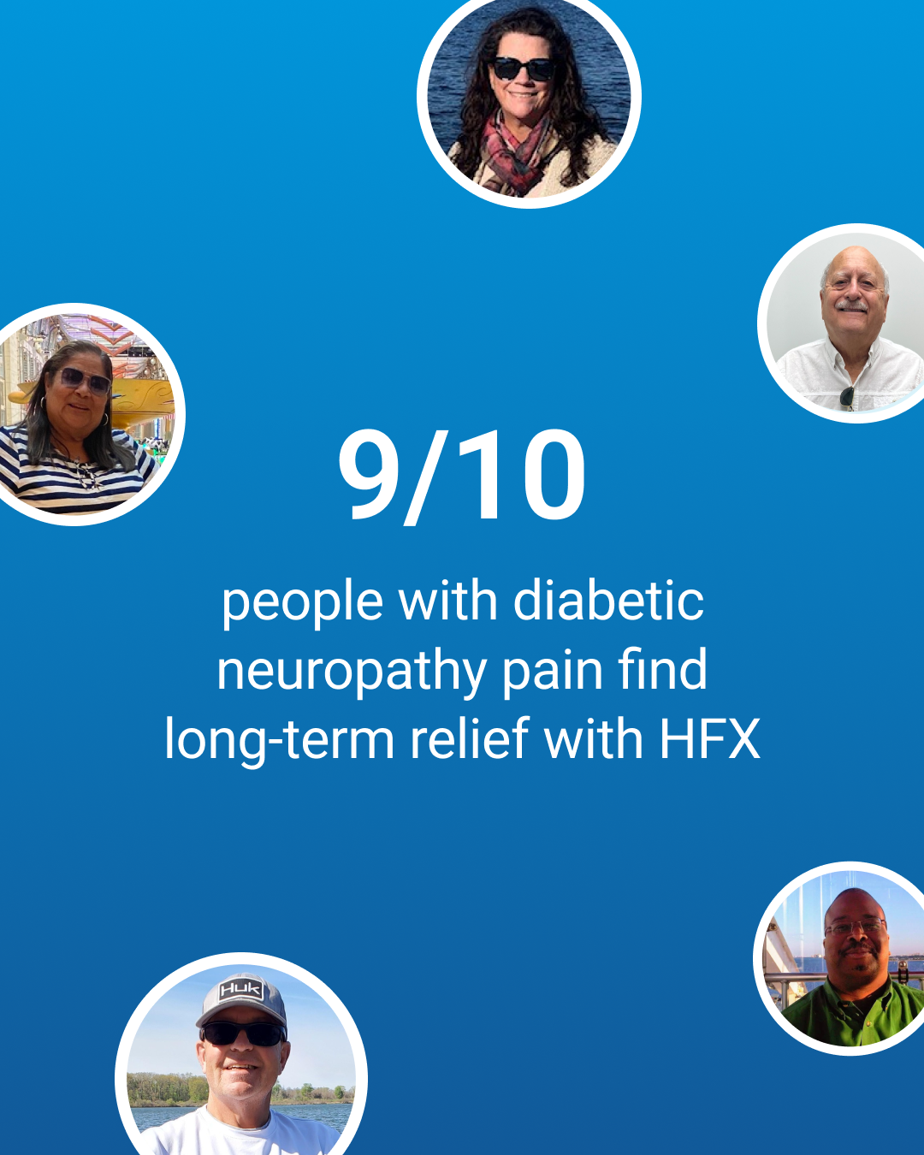
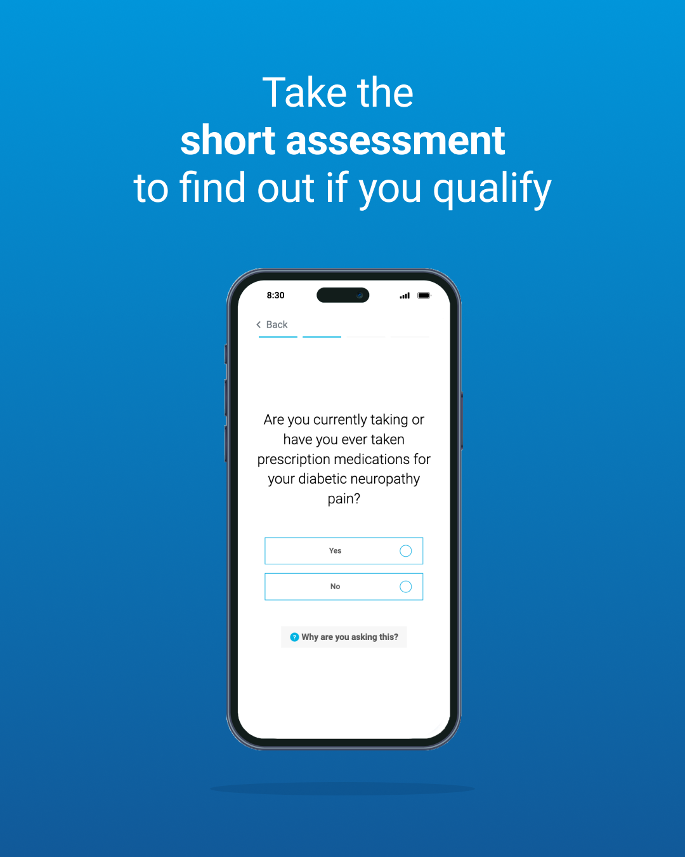
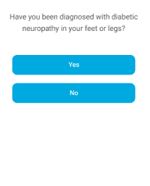

For this one, do we want to do the static as a comparison chart like the below and then the animation as one by one for the HFX column like you mentioned?
Nondrug
No Drowsiness
No Brain fog
No Typical Side effects
One Time Procedure Designed for 10 Years
Maybe each row gets added to the HFX column one by one for animation?
ANIMATED IN-FEED Version 1
1080x1350
HFXTM vs Pain Meds
Diabetic Neuropathy Relief
a
Nondrug | Drug
No Drowsiness | Drowsiness
No Brain Fog | Brain Fog
No Typical Side Effects | Typical Side Effects
One Time Procedure | Daily Pill
Designed for 10 years
Begin on our comparison chart.
Pan right to our 9/10 message. Bubbles of patients pop in and float around it.
Pan right to a phone with the assessment.
🔥 🦶 There’s now a better nondrug way to manage diabetic neuropathy pain in your feet and legs.
Diabetic Neuropathy Relief in a pill like the below:
Love this idea! Let’s show 9 patient images. I’ve added 4 more photos in Asana.
- Use screen I added
- Add nevro HFX logo lock up in bottom right corner
Within the phone, the UI swipes to the next question.

Slide 2
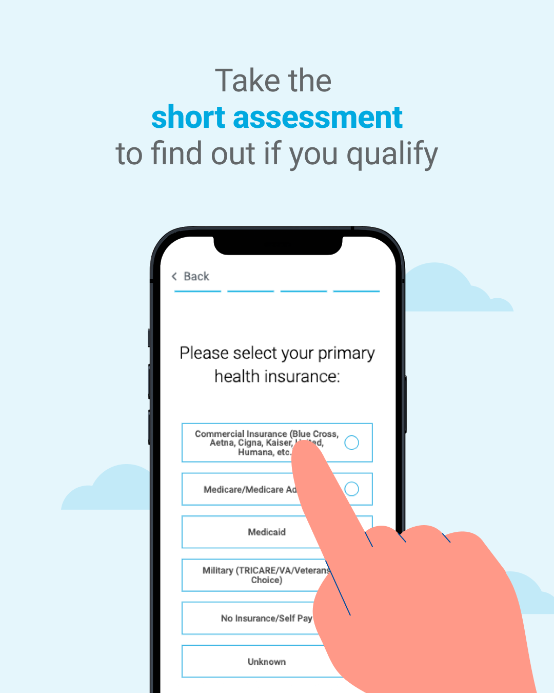
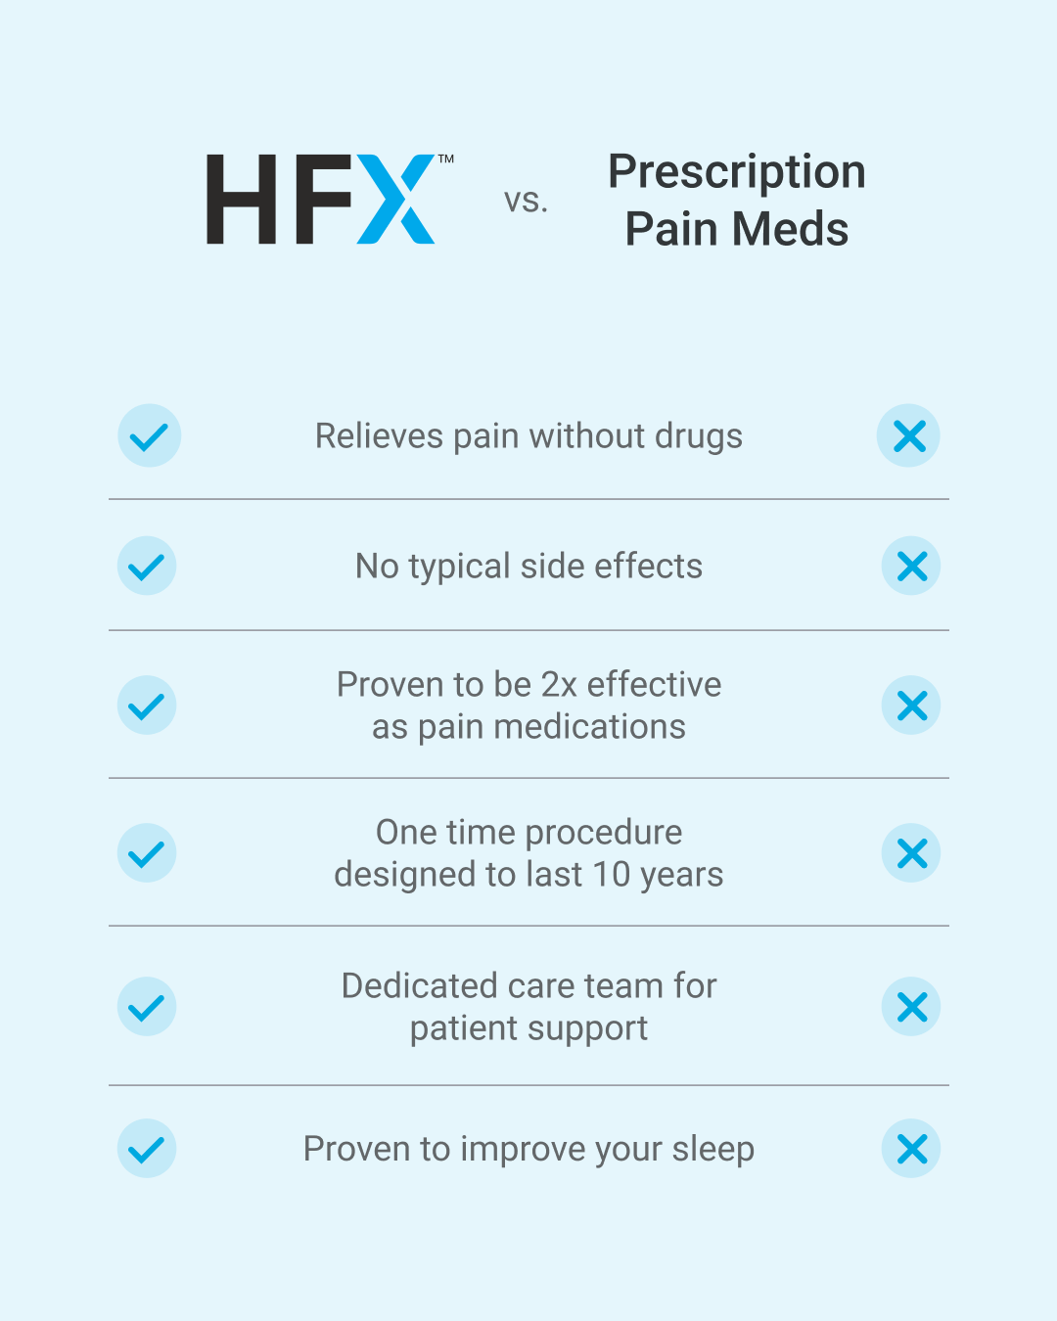
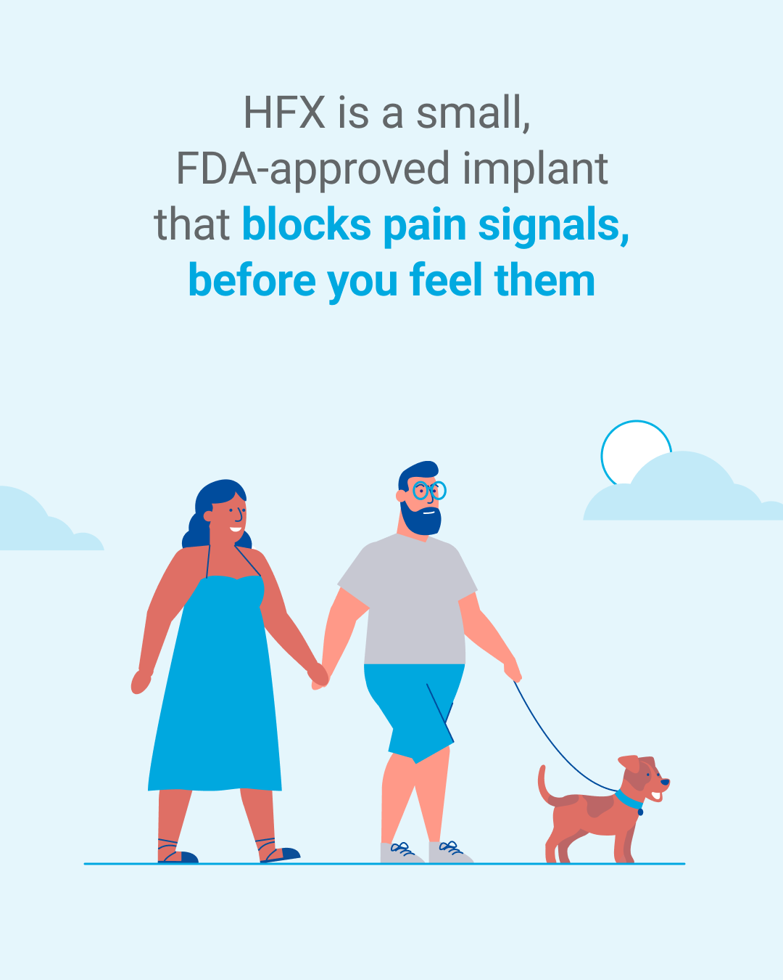
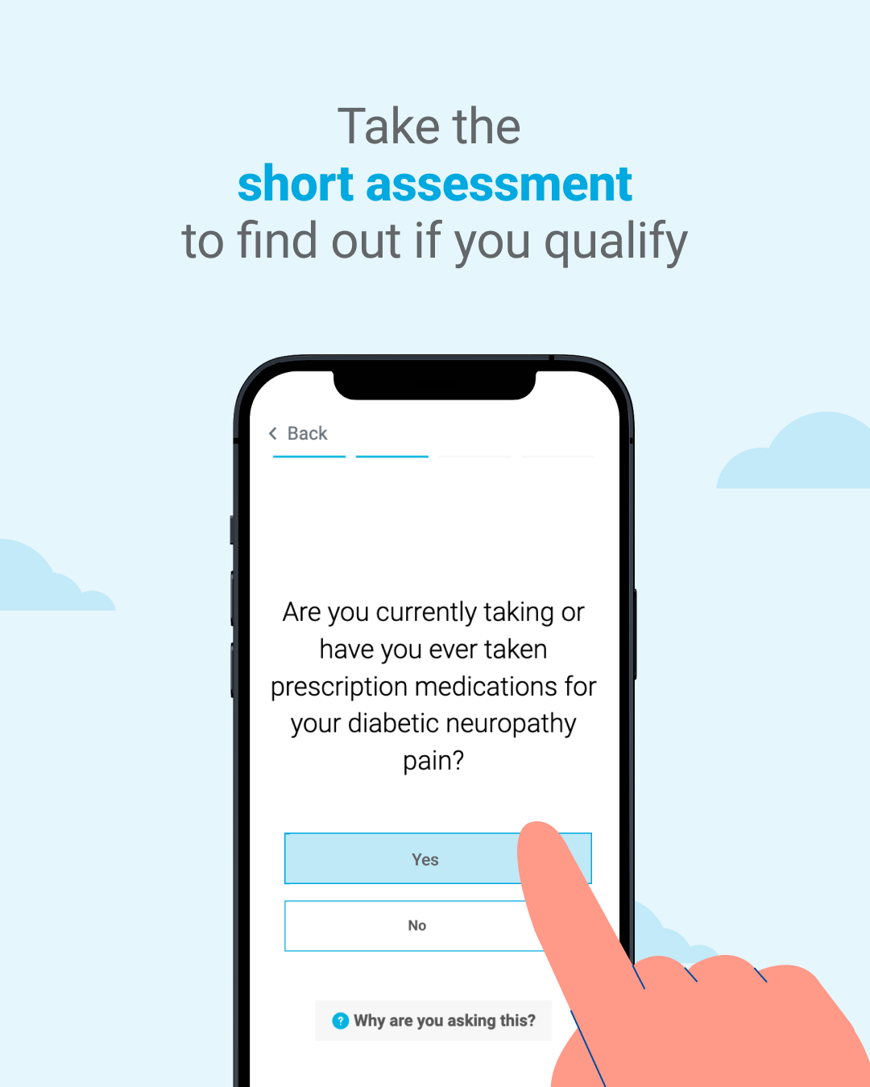
ANIMATED IN-FEED Version 2
1080x1350
Diabetic Neuropathy Relief
a
Effective when pain meds don’t work
Begin on our comparison chart. Checkmarks come in one by one..
Pan right to reveal our scene of the patient and his partner walking their dog.
Pan right within the sky to a phone with the assessment. A finger taps ‘yes’. Clouds slowly move behind them.
🔥 🦶 There’s now a better nondrug way to manage diabetic neuropathy pain in your feet and legs.
- Check marks green
X’s red
HFX above the check marks
Pain Meds above the X’s
- Use screen I added
- Add nevro HFX logo lock up in bottom left corner
Only blocks pain signs in blue
Diabetic Neuropathy Relief in a pill like the below, maybe dark blue?
The screen on the phone slides to the next question.
Use screen I added

Slide 3

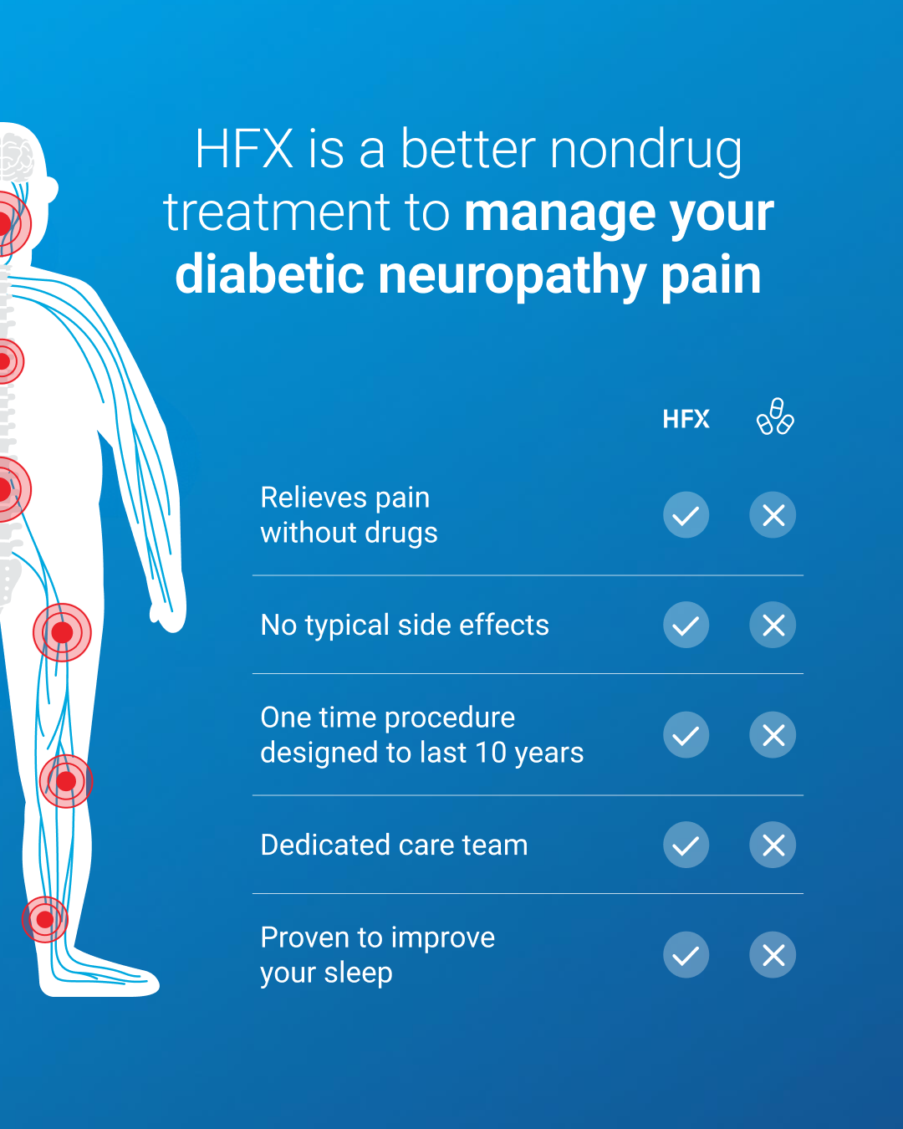

ANIMATED IN-FEED Version 3
1080x1350
a
No Drowsiness
No Brain Fog
Relieves Pain Without Drugs
One Time Procedure Designed for 10 Years
Begin on our comparison chart, with our x-ray to the left of the screen. Pain signals pulse up.
Pan right to reveal our scene of the patient and their doctor speaking.
🔥 🦶 There’s now a better nondrug way to manage diabetic neuropathy pain in your feet and legs.
- TM HFX
- Just show the leg and foot pain
Slide to the final frame, looking over the shoulder of a patient. Green checkmark pops up on phone slightly after.
- Add nevro HFX logo lock up in bottom right corner

Slide 4
SOCIAL
Static In-feed

Slide 5
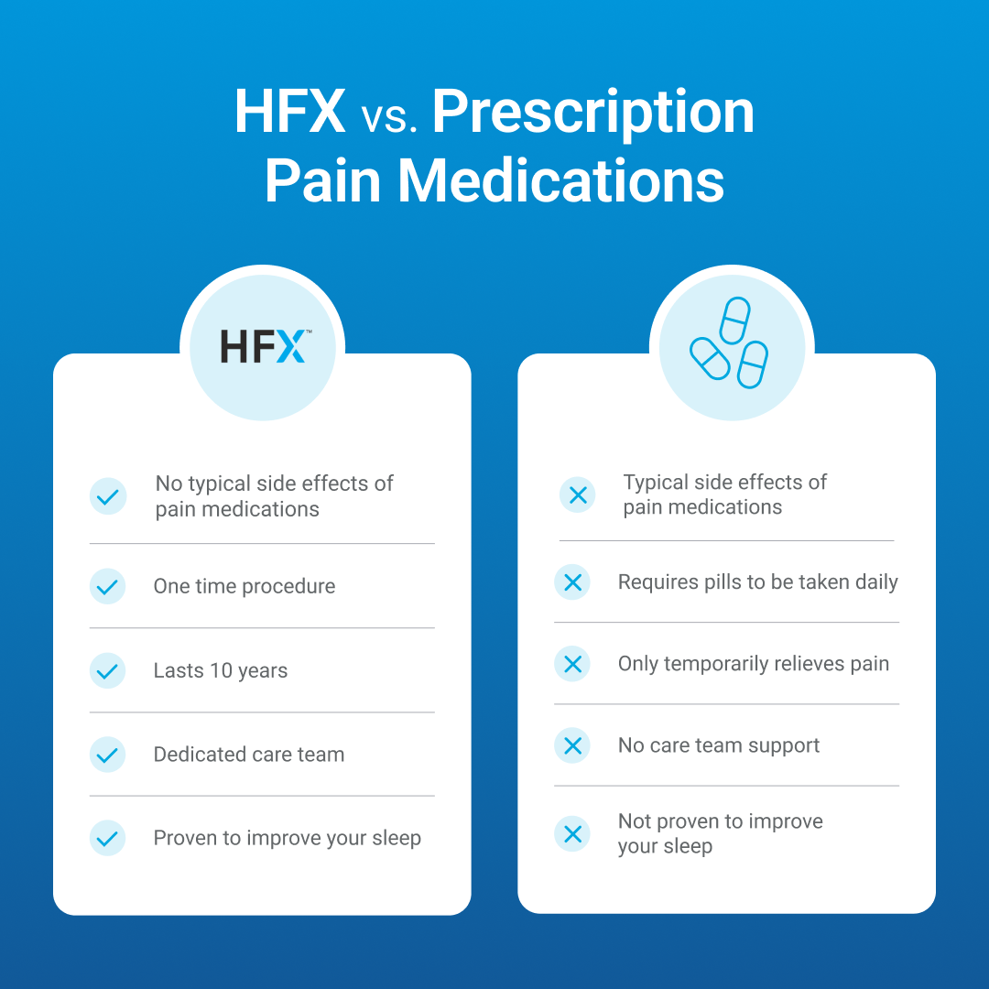
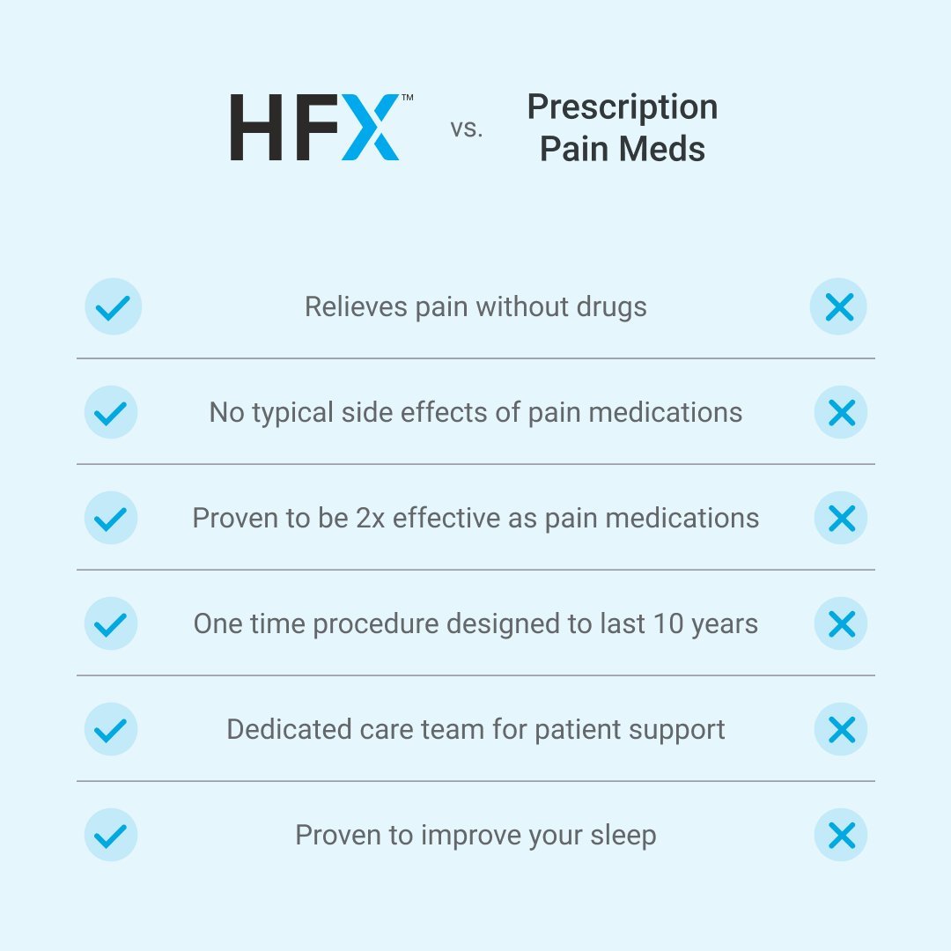
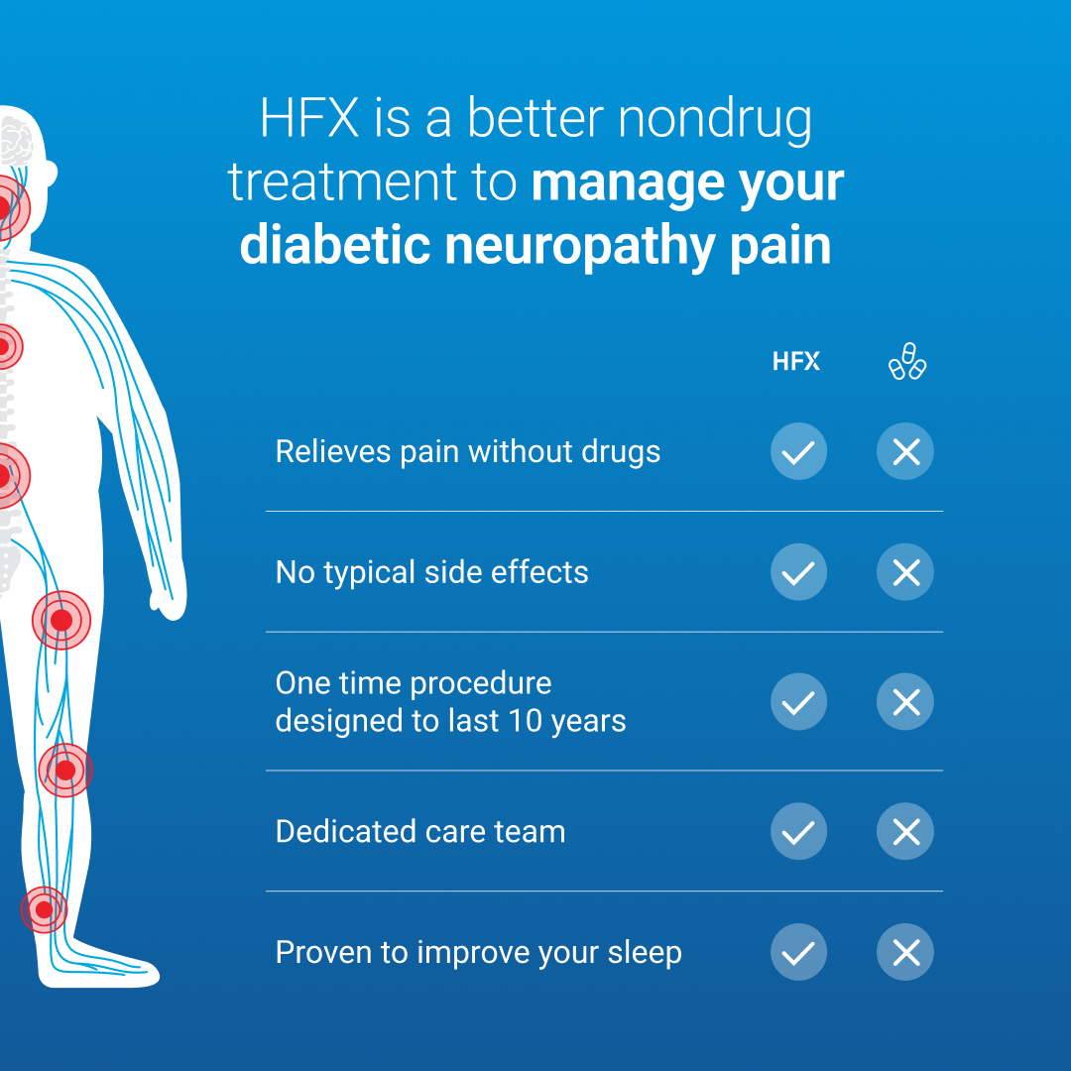
STATIC IN-FEED Static
Versions 1080x1080
Diabetic Neuropathy Relief
HFXTM vs Pain Meds
Diabetic Neuropathy Relief
Relieves pain without drugs
No typical side effects
Effective when pain meds don’t work
One time procedure designed for 10 years Dedicated care team
Nondrug | Drug
No Drowsiness | Drowsiness
No Brain Fog | Brain Fog
No Typical Side Effects | Typical Side Effects
One Time Procedure | Daily Pill
Designed for 10 years
No Drowsiness
No Brain Fog
Relieves Pain Without Drugs
One Time Procedure Designed for 10 Years
Dedicated Care Team
🔥 🦶 There’s now a better nondrug way to manage diabetic neuropathy pain in your feet and legs.
🔥 🦶 There’s now a better nondrug way to manage diabetic neuropathy pain in your feet and legs.
🔥 🦶 There’s now a better nondrug way to manage diabetic neuropathy pain in your feet and legs.
Version 1
Version 2
Version 3
Diabetic Neuropathy Relief in a pill like the below:
- Check marks green
X’s red
HFX above the check marks
Pain Meds above the X’s
- TM HFX
- Just show the leg and foot pain
Diabetic Neuropathy Relief in a pill like the below, may dark blue?

