Slide 1
Patient Marketing Business Goals
Build Patient Demand
2. Drive Growth Through Patient Web Leads and Trial Volume
3. Increase Market Share Through Revenue

Slide 2
The Problem We are Solving For
The patient team has lost the license to the previous brand platform ‘Free to’ and does not have any strong, meaningful visual brand elements to leverage that resonates with our prospective patients. We are currently only checking the box using stock imagery. We don’t stand out from our competitors, and we don’t speak to our patient customer.
We leveraged the ‘Free to’ brand for our back/leg assets. Since we lost the license, all we have available to use in our resources is two shades of blue. We leveraged the ‘ Nevro HFX’ brand for PDN patients however the stock images don’t resonate and the burning shoe images confused our prospective customers – they think we’re selling shoes. HFX is an HCP brand without any patient research. Additionally, there isn’t any cohesion and fluidity between these two brands.

Slide 3
Goal for this Campaign
To develop a compelling, original, and ownable long-term visual brand identity that strongly resonates with our patient segmentations to build demand, increase market share, and stand out from our competitors. Patient should see our brand and think "this is for me".
This campaign will serve as the parent brand for our two patient segmentations. We plan to leverage the assets from this campaign across Nevro's digital and physical patient experience.

Slide 4
Audience Profiles and Segmentation
Patient Attitudes by Etiology: https://nevro.sharepoint.com/:p:/r/sites/NevroInsightsRepository/_layouts/15/Doc.aspx?sourcedoc=%7B8770B587-9CD6-4938-BBC0-CC0F30CE2D61%7D&file=PatientAttitudesbyEtiology_US_2022.pptx&action=edit&mobileredirect=true
PDN Qualitative Research Report: https://nevro.sharepoint.com/:p:/r/sites/NevroInsightsRepository/_layouts/15/Doc.aspx?sourcedoc=%7BB9115A36-9909-43EC-98E0-430D42EAAA37%7D&file=PDN%20HFXValuePropositionDevelopment_US_2022%20FINAL.pptx&action=edit&mobileredirect=true
Komodo Data:
PDN Launch Research: https://nevro.sharepoint.com/:p:/r/sites/NevroInsightsRepository/_layouts/15/Doc.aspx?sourcedoc=%7BF39C43E1-624A-4D16-8FAC-B784D612F439%7D&file=PDNPatientJourney_WW_2020.pptx&action=edit&mobileredirect=true

Slide 5
Audience Profiles and Segmentation
Back/Leg Patient Journey Insights & Opportunities: https://nevro.sharepoint.com/sites/NevroInsightsRepository/Shared%20Documents/Forms/AllItems.aspx?as=json&FolderCTID=0x012000463367BE550A57469791059D0723D716&id=%2Fsites%2FNevroInsightsRepository%2FShared%20Documents%2FFinal%20Research%20Readouts%2FPatient%20Journey%2FB%26LPatientJourneyQual%5FUS%5F2021%2Epdf&viewid=7b007456%2D8e63%2D4ed9%2Dbea0%2Df7b8a14e8bf9&parent=%2Fsites%2FNevroInsightsRepository%2FShared%20Documents%2FFinal%20Research%20Readouts%2FPatient%20Journey
HFX iQ Patient Messaging Research: https://nevro.sharepoint.com/sites/NevroInsightsRepository/Shared%20Documents/Forms/AllItems.aspx?id=%2Fsites%2FNevroInsightsRepository%2FShared%20Documents%2FFinal%20Research%20Readouts%2FHFX%20iQ%2FHFX%20iQ%20S2%20Patient%20Messaging%20and%20Claims%5FQual%5FUS%5F2022%2Epdf&viewid=7b007456%2D8e63%2D4ed9%2Dbea0%2Df7b8a14e8bf9&parent=%2Fsites%2FNevroInsightsRepository%2FShared%20Documents%2FFinal%20Research%20Readouts%2FHFX%20iQ

Slide 6
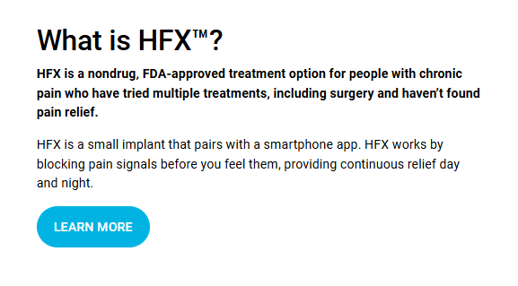
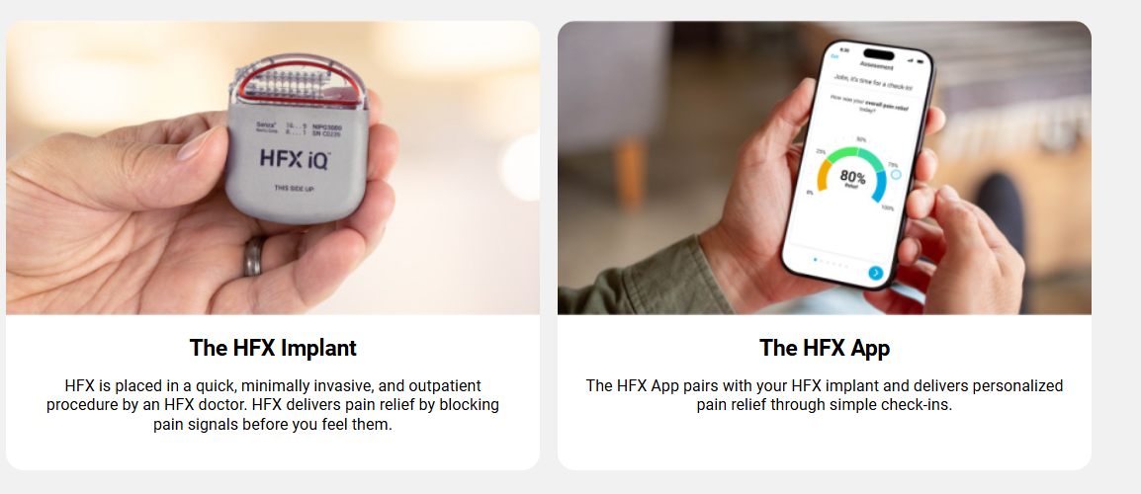
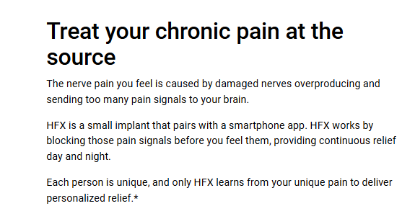
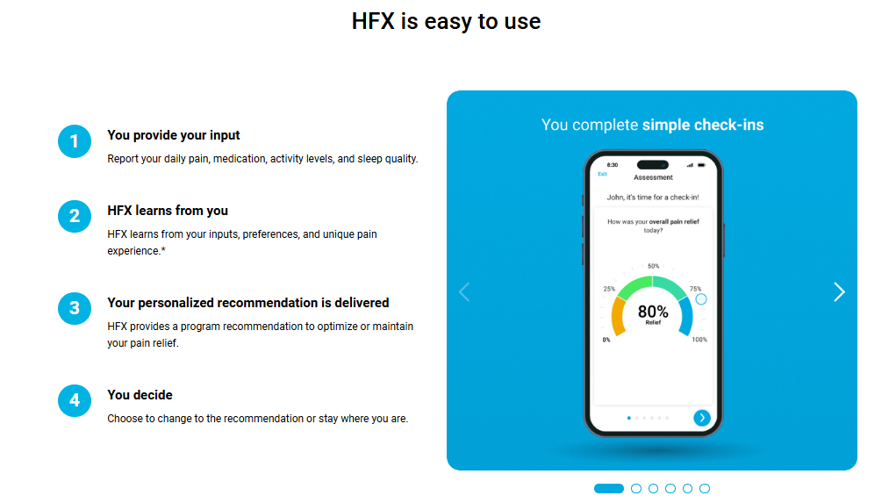
Patient Facing Product Details | Back/Leg

Slide 7
Resources for Back/Leg Messaging
NevroHFX.com Home Page: https://www.nevrohfx.com/
NevroHFX.com How HFX Works Page: https://www.nevrohfx.com/why-hfx/how-hfx-works/
How HFX works video: https://www.nevrohfx.com/vlp/how-does-nevro-hfx-work/
In practice trifold: https://nevro.box.com/s/ne2t7lkr8qg51cyg3oyaep6vqpv41q0m
In practice brochure:
Back/Leg Facebook: https://www.facebook.com/NevroHFX

Slide 8
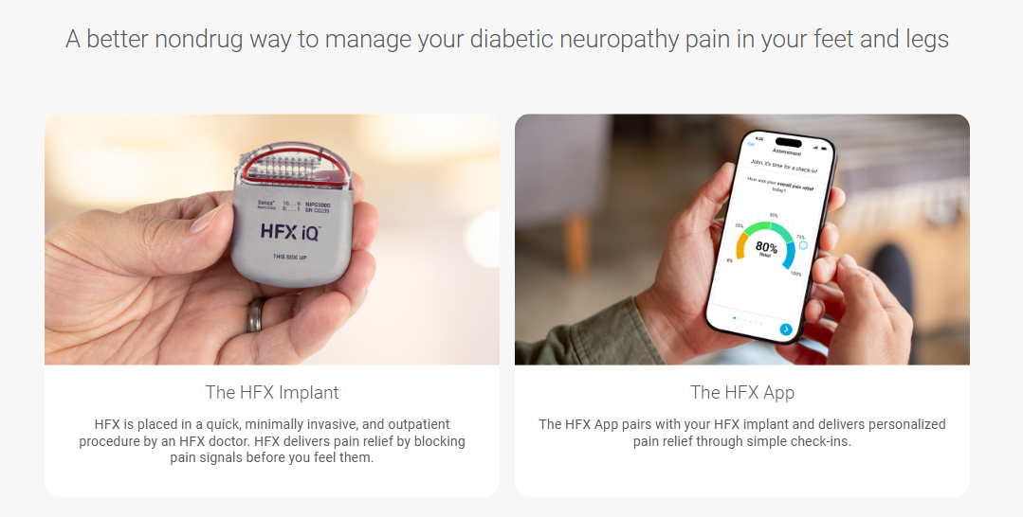
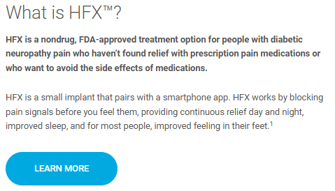
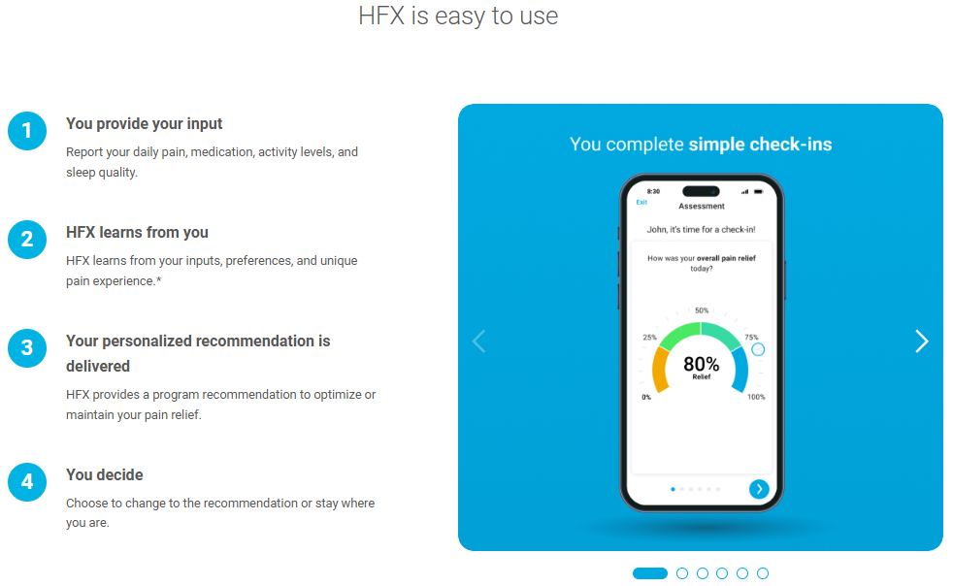
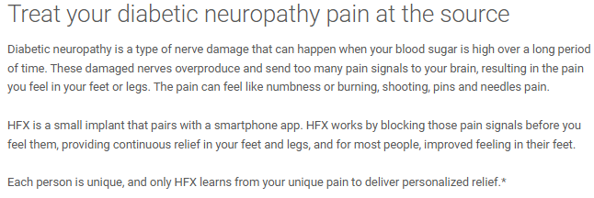
Patient Facing Product Details | PDN

Slide 9
Resources for PDN Messaging
HFXforPDN.com Home Page: https://www.hfxforpdn.com/
HFXforPDN.com How HFX Works Page: https://www.hfxforpdn.com/why-hfx/how-hfx-works/
In practice trifold: https://nevro.box.com/s/501icfxvi1cr9d6a1znr4f48rfvewzdh
In practice brochure:
Digital guide: https://www.hfxforpdn.com/app/uploads/2024/10/HFX-Introduction-to-Diabetic-Neuropathy-Relief-Patient-Guide.pdf
How HFX works video storyboard: https://nevro.box.com/s/z7zb5k6rq9bm74rwflr16ihaaablxk7m
PDN Facebook: https://www.facebook.com/HFXforPDN/

Slide 10

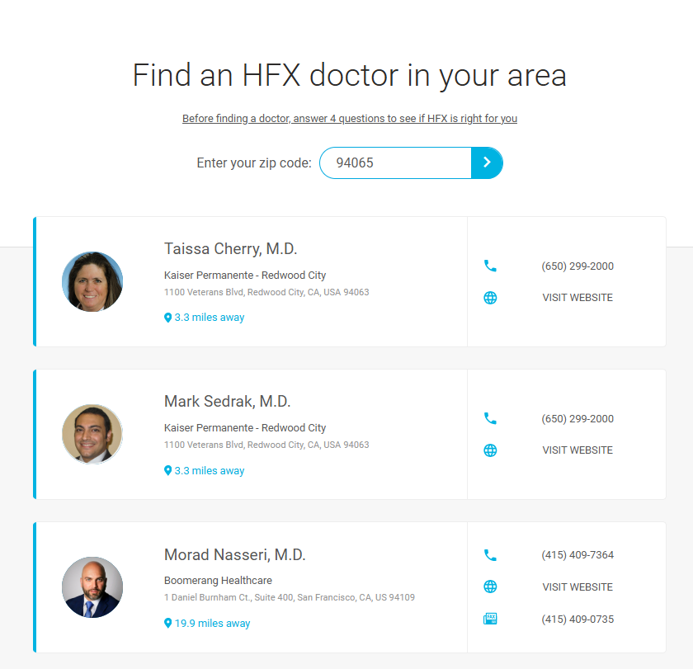
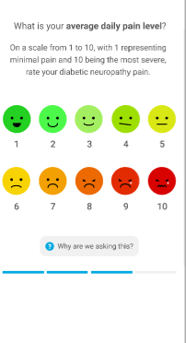
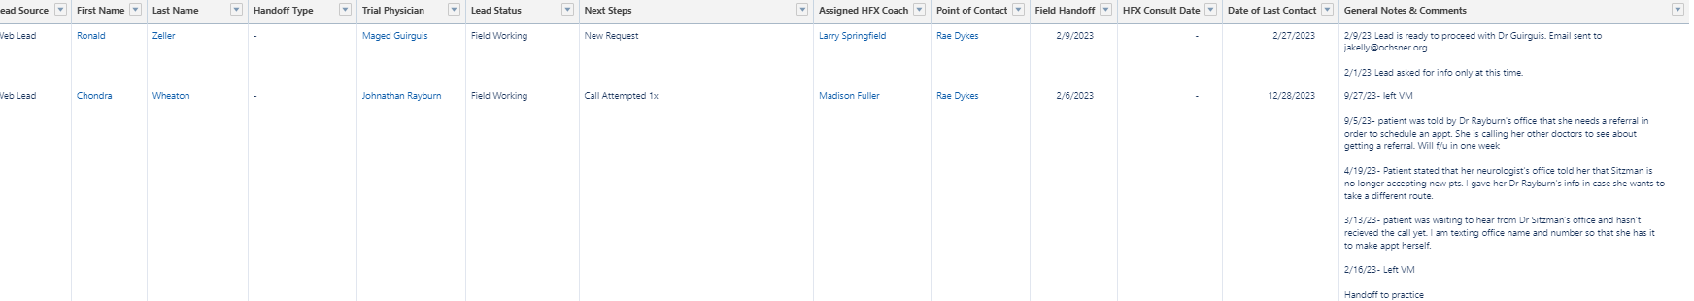
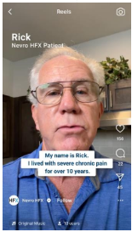
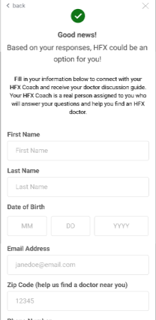
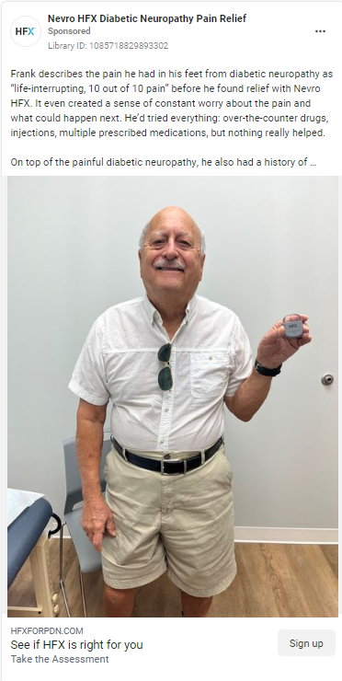




Marketing Strategy |Moving Patients Through the Funnel for Consultations
Advertising
Lead Capture
HFX Coach Education & HCP Connection
Practice or Sales Hand Off

Slide 11
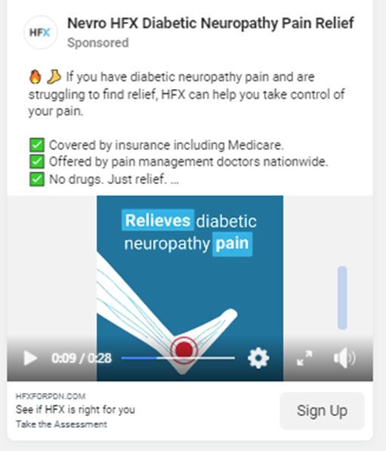
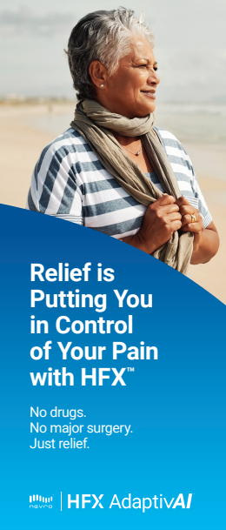


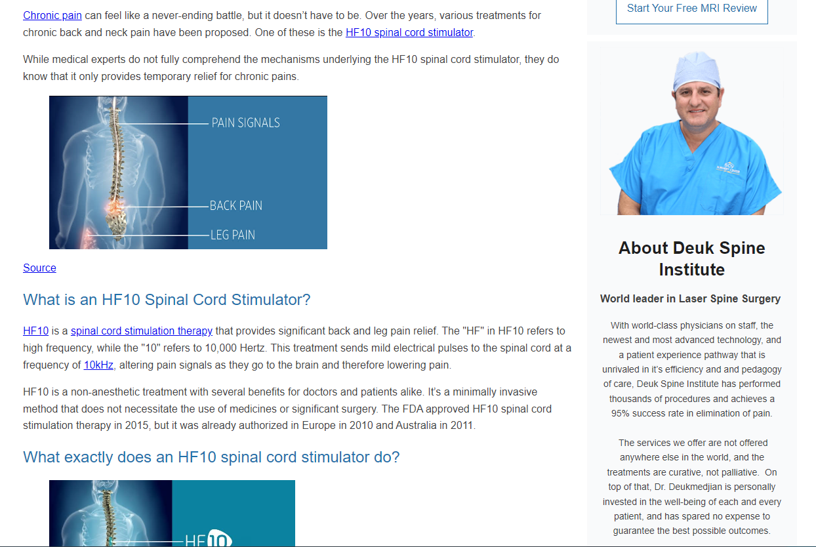


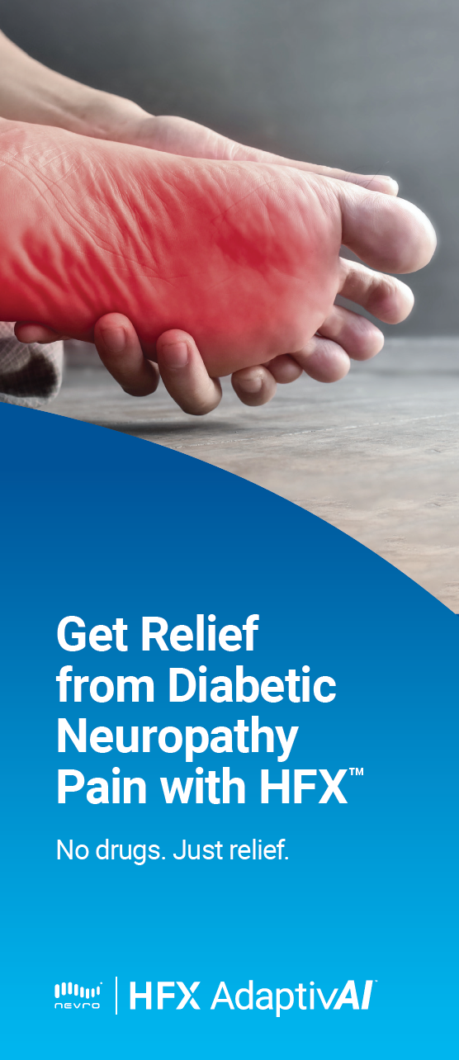
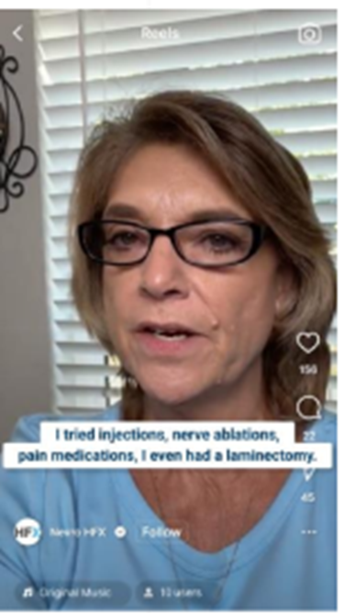


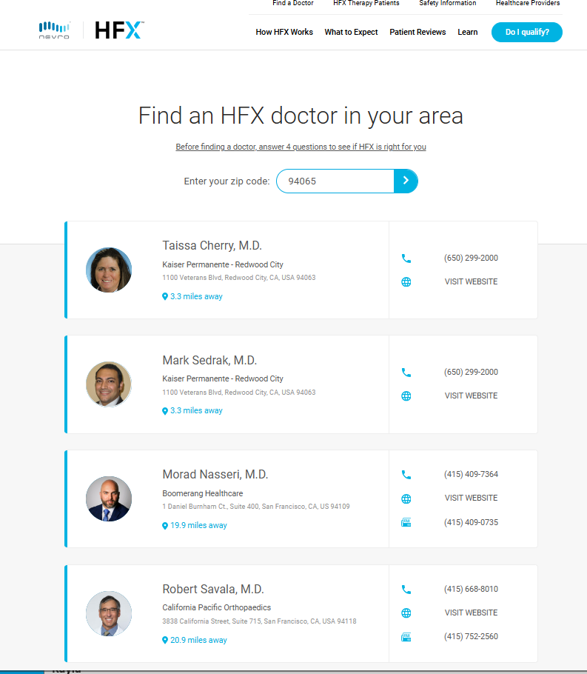
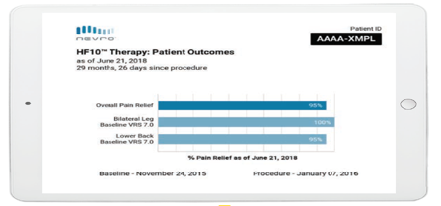
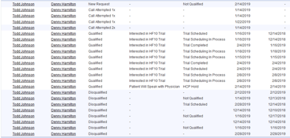
3 Primary Channels This Brand Will Be Leveraged Across
DTC Digital Lead Generation:
In-practice Patient Education:
HCP Practice Marketing:

Slide 12

We Are Currently Advertising on Four Channels for PDN
Facebook
Instagram
YouTube
Google
Areas of expansion we’re exploring for 2025:
TikTok
CTV
We will be relaunching back/leg next year.

Slide 13
Advertising Targeting Strategy
In a compliant way, focusing on 30 specific geographies where patients have access to HFX, and the geographies where prospective patients had the highest % of consult dates.
We're in the process of adding 15 more territories.
Goal: to maximize DTC spend where it will have the most impact and identify SCS trial candidates.

Slide 14
Preliminary Program Metrics 8/14 to 10/31
Leads | 7,007
PDN Leads % of leads | 6,413
Contacted % of leads | 6576 94%
Days to contact | <1 business day
Reached % of Contacted | 2995 46%
Qualified (Interested) % of Reached | 1885 62%
Handed off % of Reached | 1307 69%
Handed directly to practice % of handed off | 490 37%
Consults booked through HCP | 346
Avg days from hand off to practice to consult date | 24 days

Slide 15
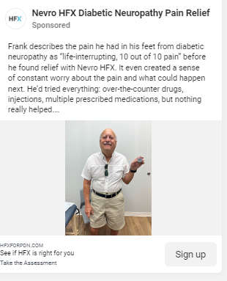
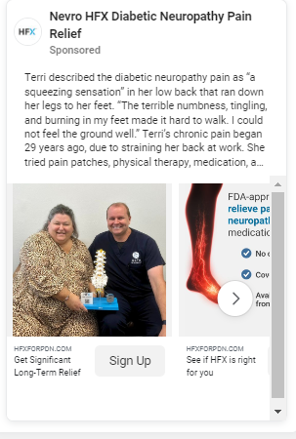
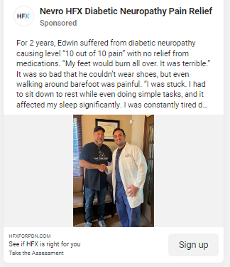
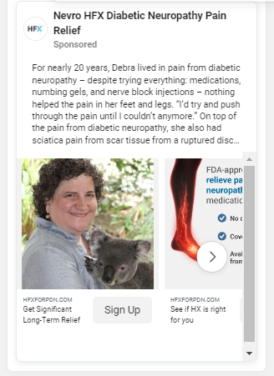
Campaigns | Patient Stories (Traditional UGC) Advertisements
Top performing ads, patients love to hear from people just like them. Stories with length and severity of pain perform the best.
For back/leg stories that start with prior treatments listed and specifically listing back surgeries like a fusion perform the best.

Slide 16
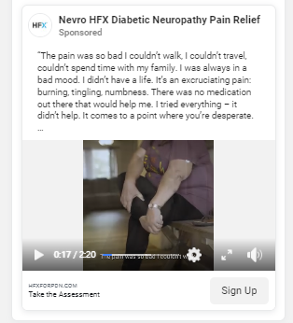
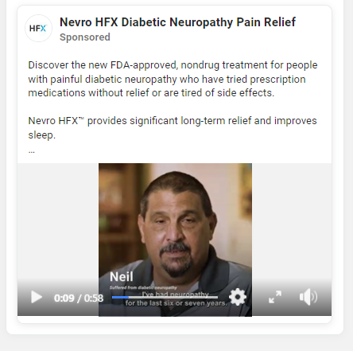
Campaigns | Patient Testimonial Videos (Traditional UGC) Advertisements

Slide 17

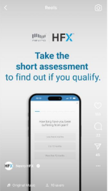
Campaigns | Patient Ambassador UGC
We're looking to invest in more UGC next year and leverage our patient experience.

Slide 18

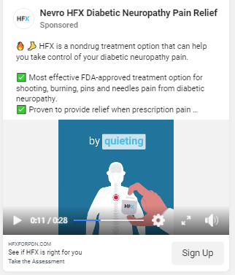
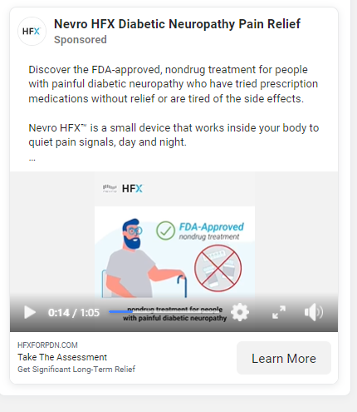
Campaigns | How HFX Works Animation Advertisements

Slide 19
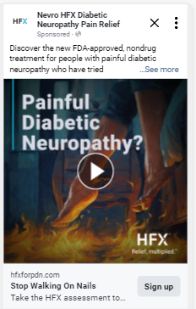
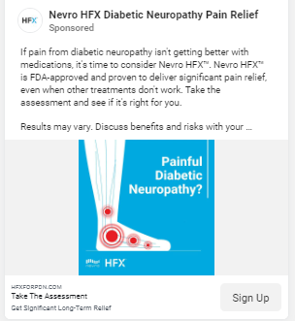
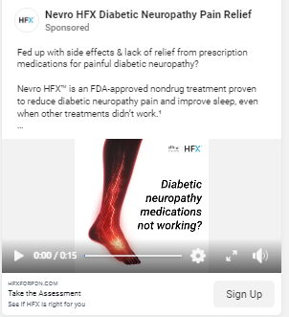
Campaigns | Feet Advertisements

Slide 20
Campaigns | What Didn't Work

Slide 21
Biggest Challenges
We want the patient brand to focus on the patient experience, not the company.
How to stand apart from competitors and traditional SCS (especially back/leg). There is low brand differentiation awareness.
Brand elements should be ownable by and original to Nevro.

Slide 22
Hesitations Patients Have to Move Forward (PDN)
Insurance coverage

Slide 23
Hesitations Patients Have to Move Forward (CBL)
Insurance coverage

Slide 24
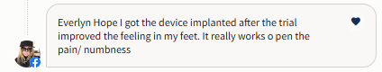
What Matters to PDN Patients

Slide 25


Direct Quotes From Where Prospective Patients Are Today

Slide 26
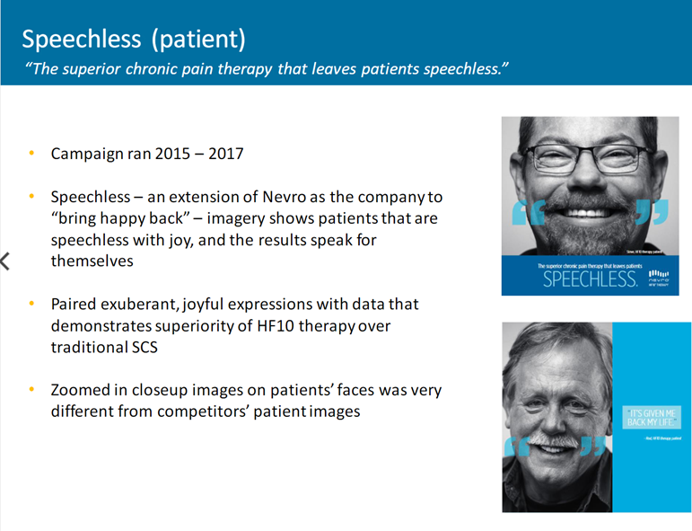
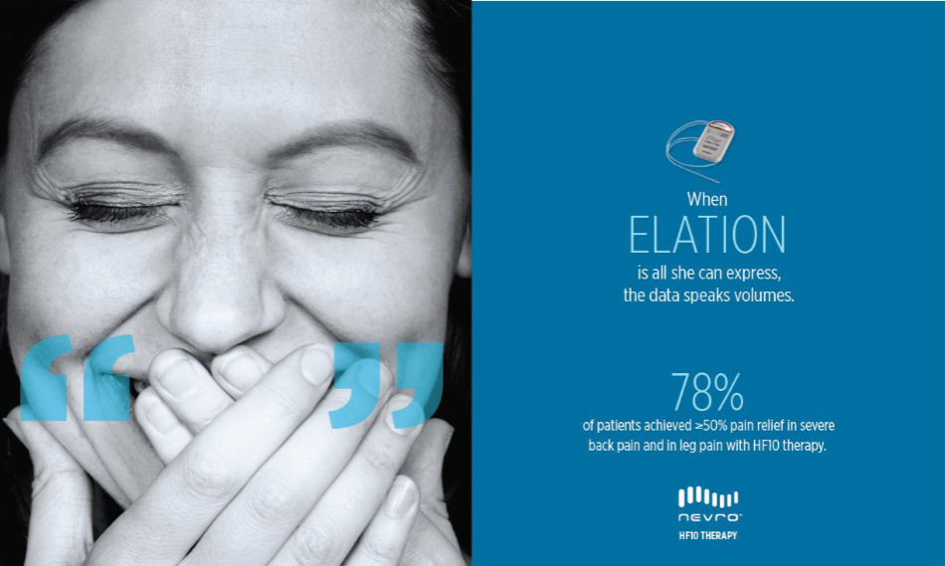
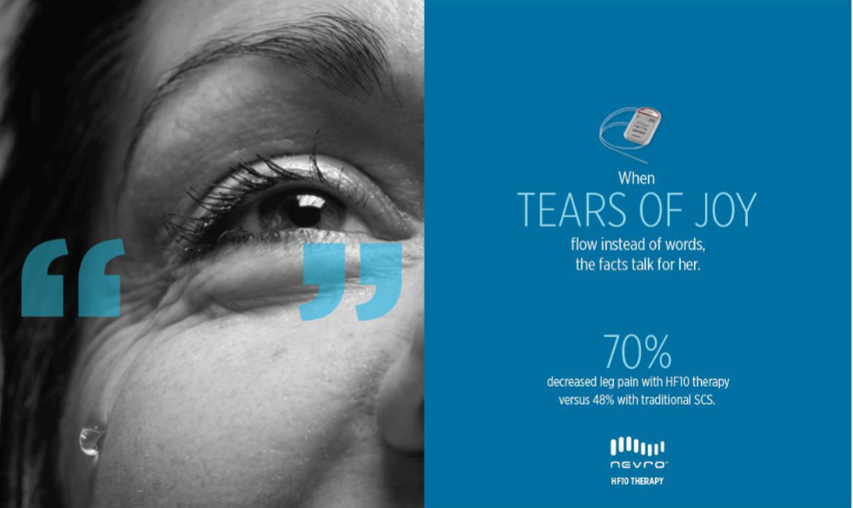
Past Brand Campaigns | Speechless
Brand deck: https://nevro.box.com/s/1f74gltmyjo6aehpk8k4qu9sm4mllnog
Assets: https://nevro.box.com/s/j1df9xxynmwsywsces6s4ekemaactpgl

Slide 27

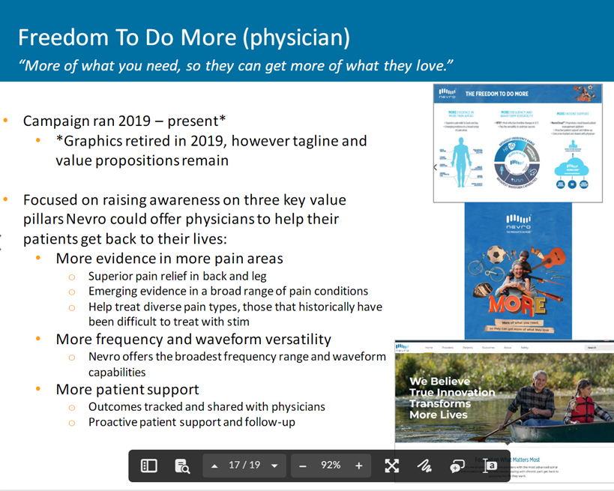

Past Brand Campaigns | Freedom to do More
Assets: https://nevro.box.com/s/ixrgy7hca6umytp8tzrvkgh4crgnsxvq
Notes:
Wasn’t well received by the field and HCPs. Focused on nostaligia. Patient brand also needs to be something HCPs want to feature in their office.

Slide 28
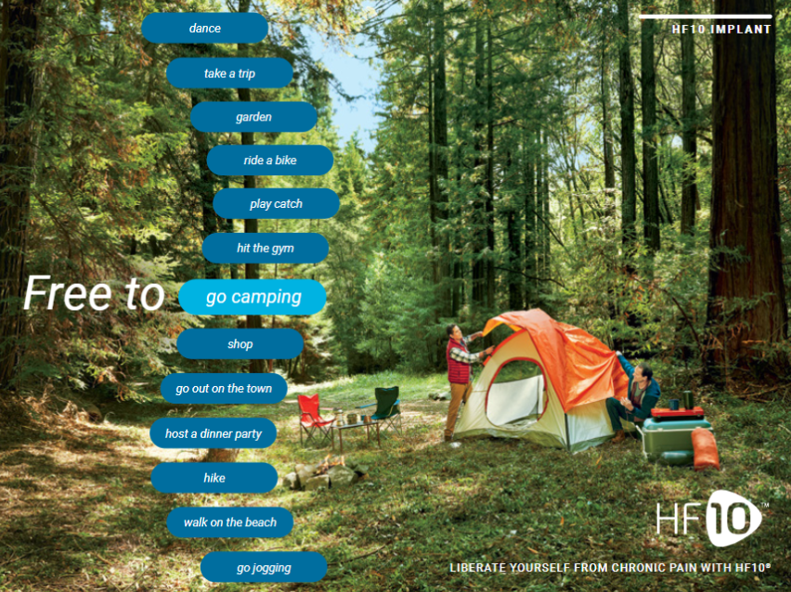
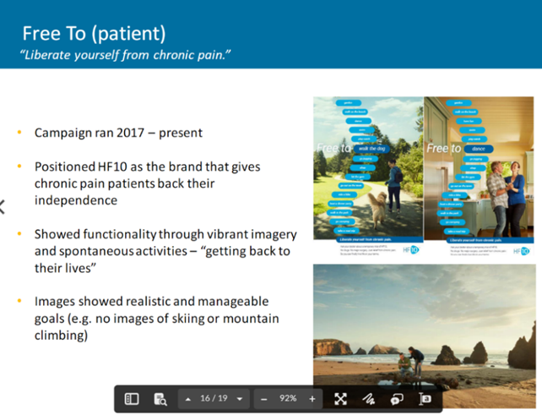
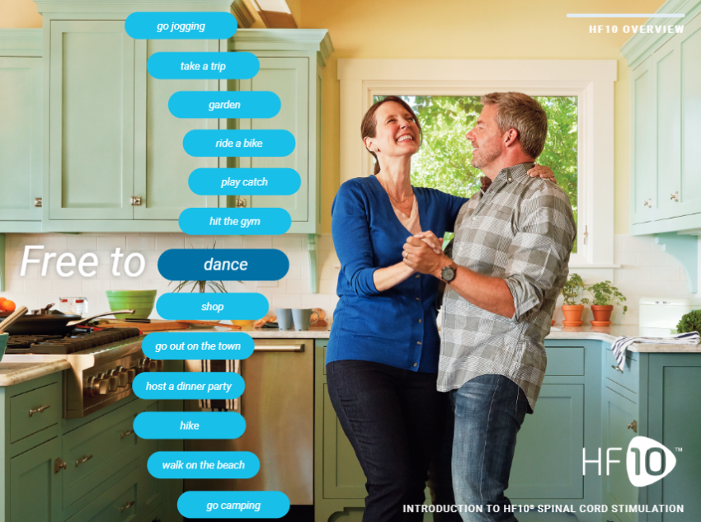
Past Brand Campaigns | Free to
Assets: https://nevro.box.com/s/csjw2xdwgnpoiaj8kbaqlzcbcxmr4uqj
Notes:
Was semi well received however felt too aspirational (hiking, camping) and doesn’t stand out from competitors. Probably the most well received out of all brand platforms. However, models they chose aren’t relatable to the patient either.

Slide 29

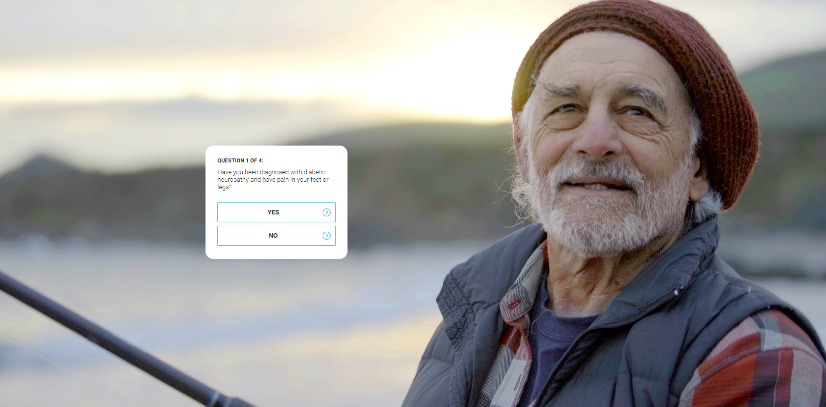

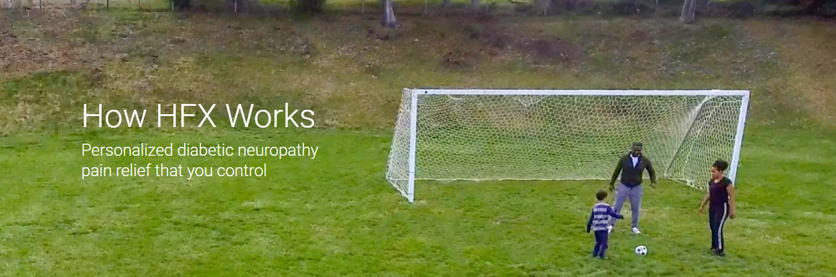
Past Brand Campaigns | Nevro HFX Brand
Assets: https://nevro.box.com/s/luksg2jxx7nyp75oii18wwc3by0e5whw
Notes:
Was an HCP brand that the PDN leveraged for launch. Was not well received because it’s not a patient centric brand and there’s no patient research behind it. Uses stock imagery, not very personal.

Slide 30
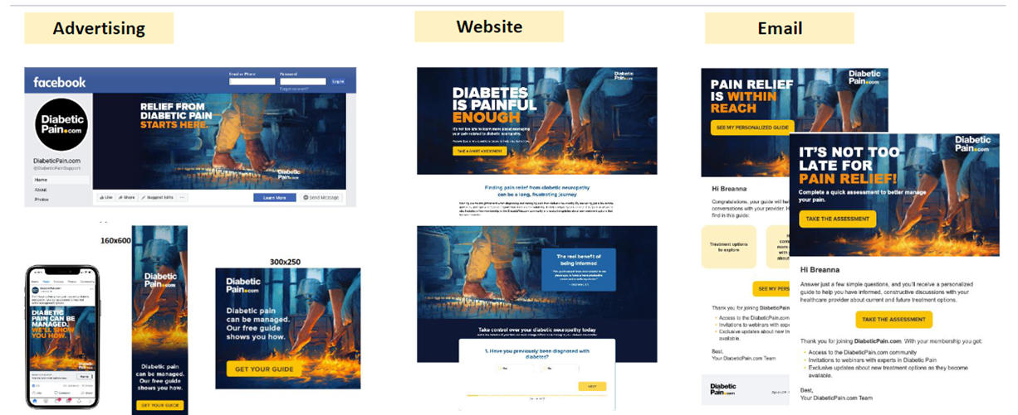
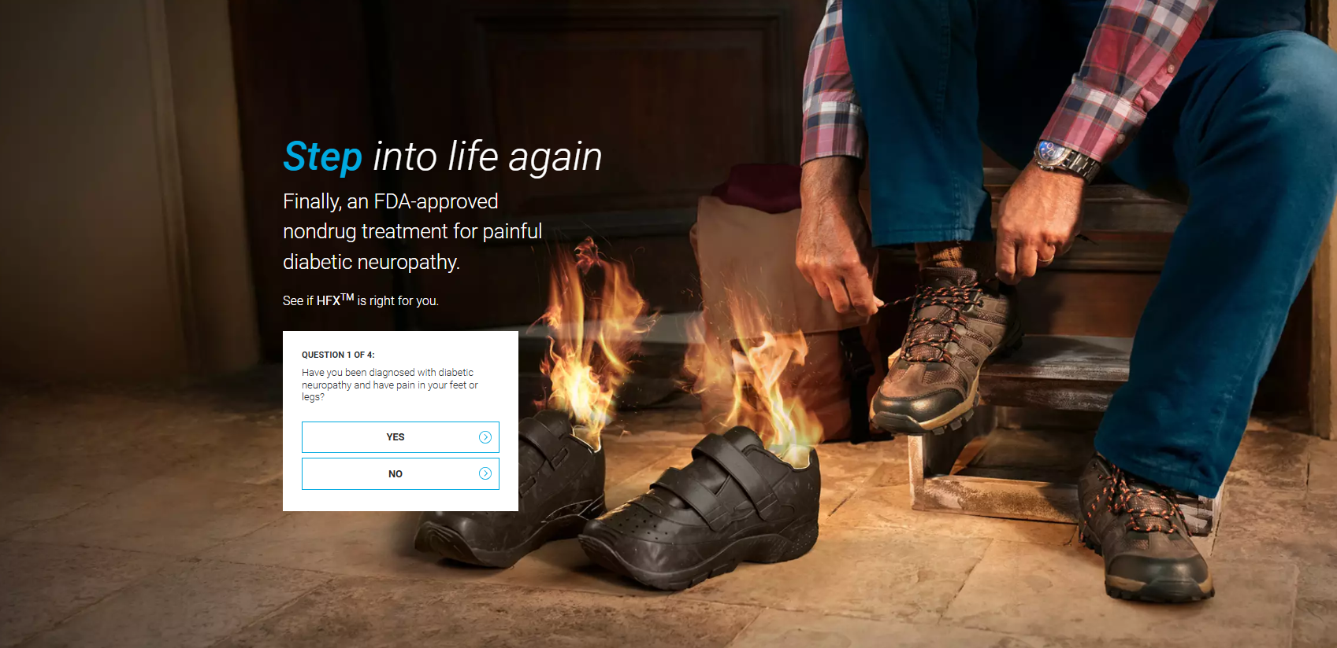
Past Brand Campaigns | Unbranded PDN Campaign
Notes:
Confusing for PDN patients, most leads called in thinking HFX was a shoe.

Slide 31
Healthcare Brands Inspiration
https://www.talkspace.com/
https://www.hims.com
https://www.hers.com
https://getcurex.com
https://www.betterhelp.com/
https://www.invisalign.com/
https://www.inspiresleep.com/en-us/
https://www.omnipod.com/
https://www.watchman.com/en-us/home.html
https://www.dexcom.com/
https://www.eversensecgm.com/

